Slide 1
Taming the brain networks: metadiagnostic strategies for dealing with mood disorders
Vladimir Maletic, MD, MS
Clinical Professor of Psychiatry and Behavioral Science
University of South Carolina School of Medicine
Greenville, South Carolina

Slide 2
Faculty Disclosure
Dr. Maletic: Consultant—AbbVie/Allergan, Acadia Pharmaceuticals, Inc., Alfasigma, USA, Inc., Alkermes, Inc., Eisai, Intra-Cellular Therapies, Ironshore, Janssen, Lundbeck A/S, Jazz Pharmaceuticals, Noven, Neurelis, Pharmaceuticals Inc, Otsuka America Pharmaceutical, Inc., Relmada, Sage Pharmaceuticals, Sunovion Pharmaceuticals Inc., Supernus Pharmaceuticals, Inc., Takeda Pharmaceutical Company Limited
Speakers Bureau—AbbVie, Acadia, Alkermes, Inc., Allergan, Eisai, Ironshore, Intra-Cellular, Janssen, H. Lundbeck A/S, Otsuka America Pharmaceutical, Inc., Sunovion, Supernus Pharmaceuticals Inc., Takeda Pharmaceutical Company Limited
Speakers Bureau (spouse)—Otsuka.

Slide 3
Learning objectives:
Define structure and function of major brain networks and delineate their clinical significance
Discuss the aberrant relationship between and within major functional brain networks in mood disorders and their relationship with clinical symptoms
Select optimal treatment approaches based on their theoretical ability to normalize functioning of major brain networks in mood disorders

Slide 4
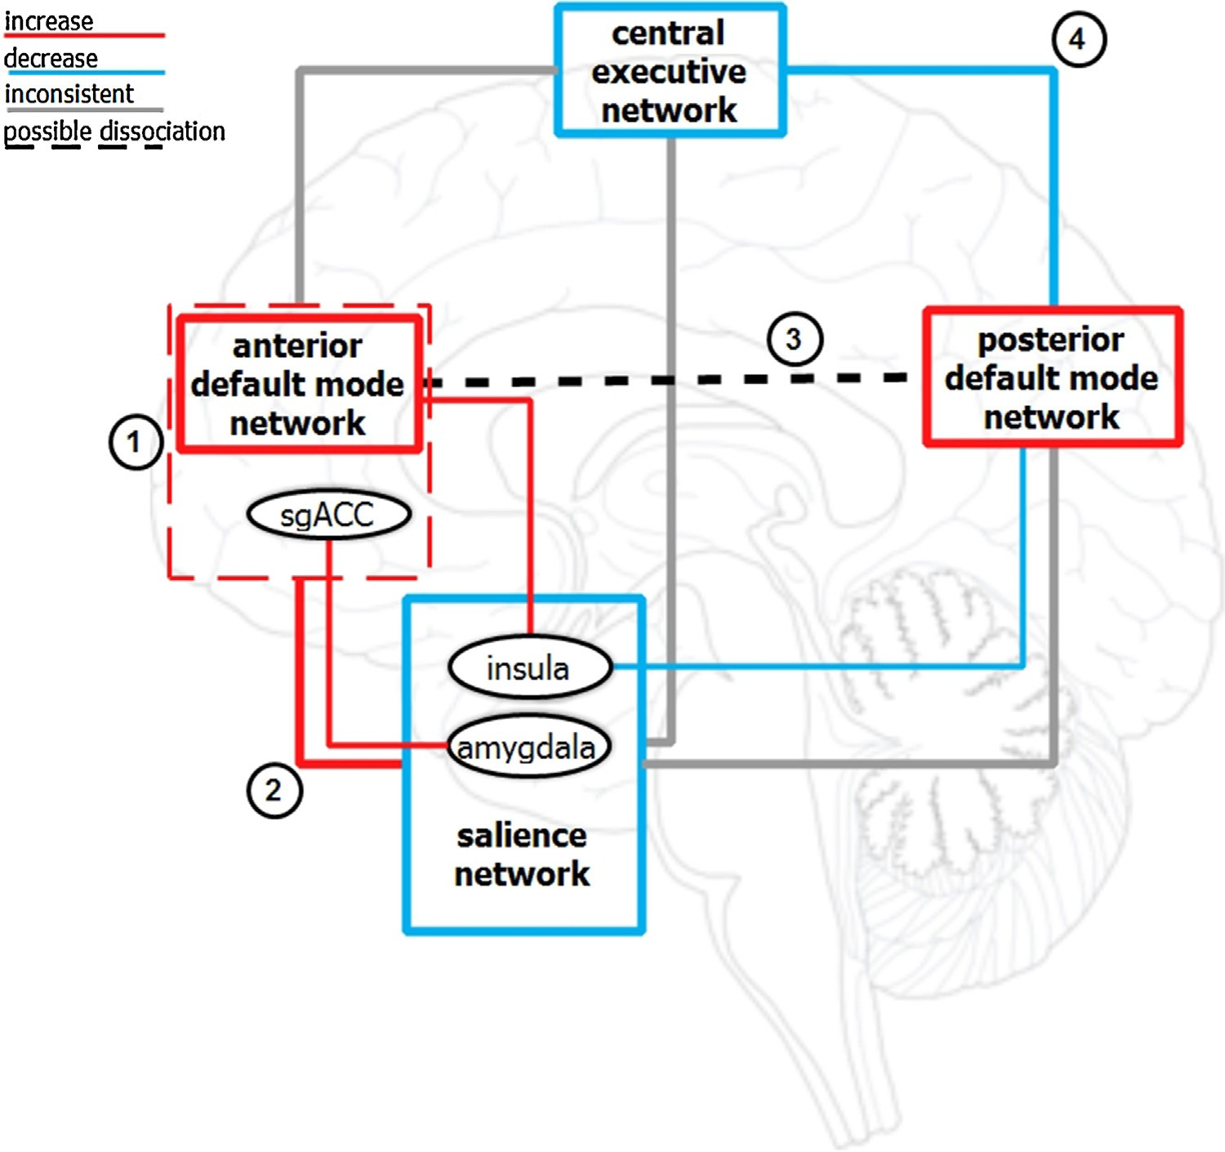
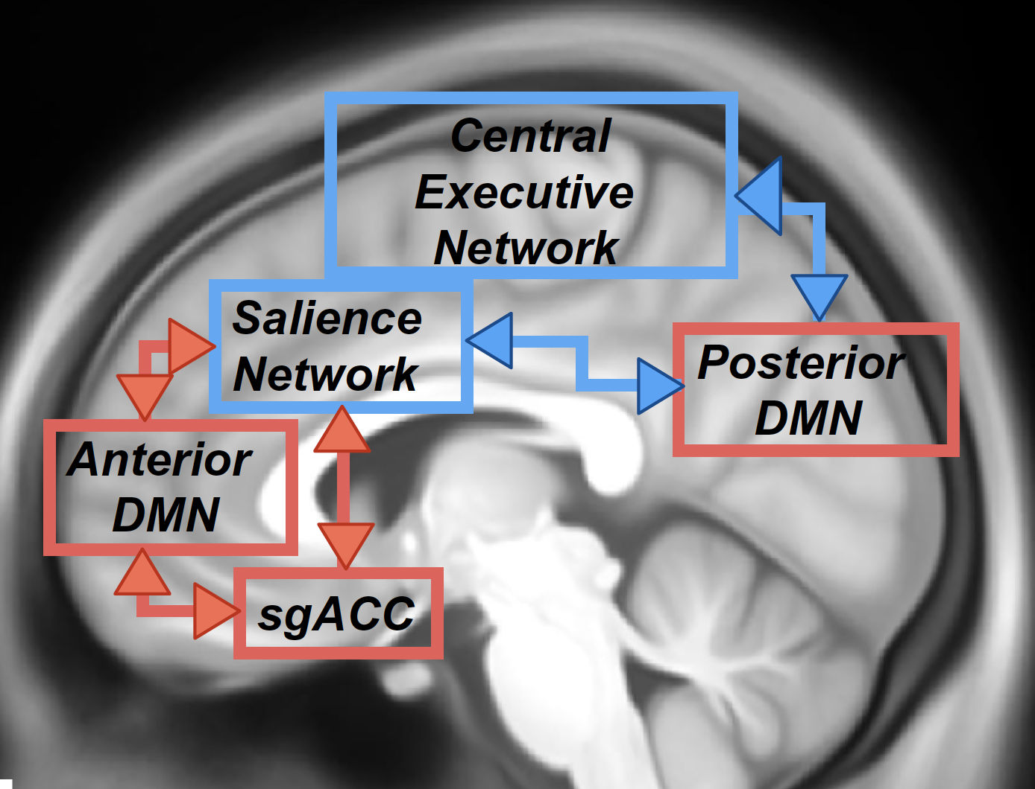
Symptoms of depression reflect aberrant functional network connectivity in MDD
Dunlop et al, 2019, Curr Psychiatry Rep, 21: 87 ; Mulders et al. 2015, Neuroscience and Biobehavioral Reviews, 56:330–344

Slide 5
Salience Network, Anatomical Name:
Mid-Cingulo-Insular Network
Physiologic Condition
Salience attribution
Detection and autonomic reaction to salient sensory stimuli
Interoceptive awareness
Reward signaling
Involved in switching between DMN and CEN
dACC
IC
Salience Network-Associated Symptoms in
Mood Disorders
Low motivation/enthusiasm
Anhedonia
Negative emotions (anxiety and depression), anxious avoidance
Inadequate emotional control
Inattentiveness
Symptom severity
Elevated pretreatment Salience Network activity is associated with antidepressant and rTMS response
Amy
VTA/SN
TP
The Salience Network consists of the insular cortex (IC), dorsal anterior cingulate cortex (dACC), amygdala (Amy), nucleus accumbens (NAcc), ventral tegmental area (VTA), temporal pole (TP), substantia nigra (SN).
Mulders et al. Neurosci Biobehav Rev. 2015;56:330. Menon. Trends Cogn Sci. 2011;15:483. Bär et al. NeuroImage. 2016;134:53.
Brakowski et al. J Psychiatr Res. 2017;92:147. Goldman-Piekarski et al. Biol Psychiatry. 2022;91:561. Dunlop et al. Curr Psychiatry Rep. 2019;21:87. Bi et al. Transl Psychiatry. 2022;12:143.
Notes:
Amy, amygdala; CEN, central executive network; dACC, dorsal anterior cingulate cortex; DMN, default mode network; IC, insular cortex; Nacc, nucleus accumbens; rTMS, repetitive transcranial magnetic stimulation; SN, substantia nigra; TP, temporal pole; VTA, ventral tegmental area .

Slide 6
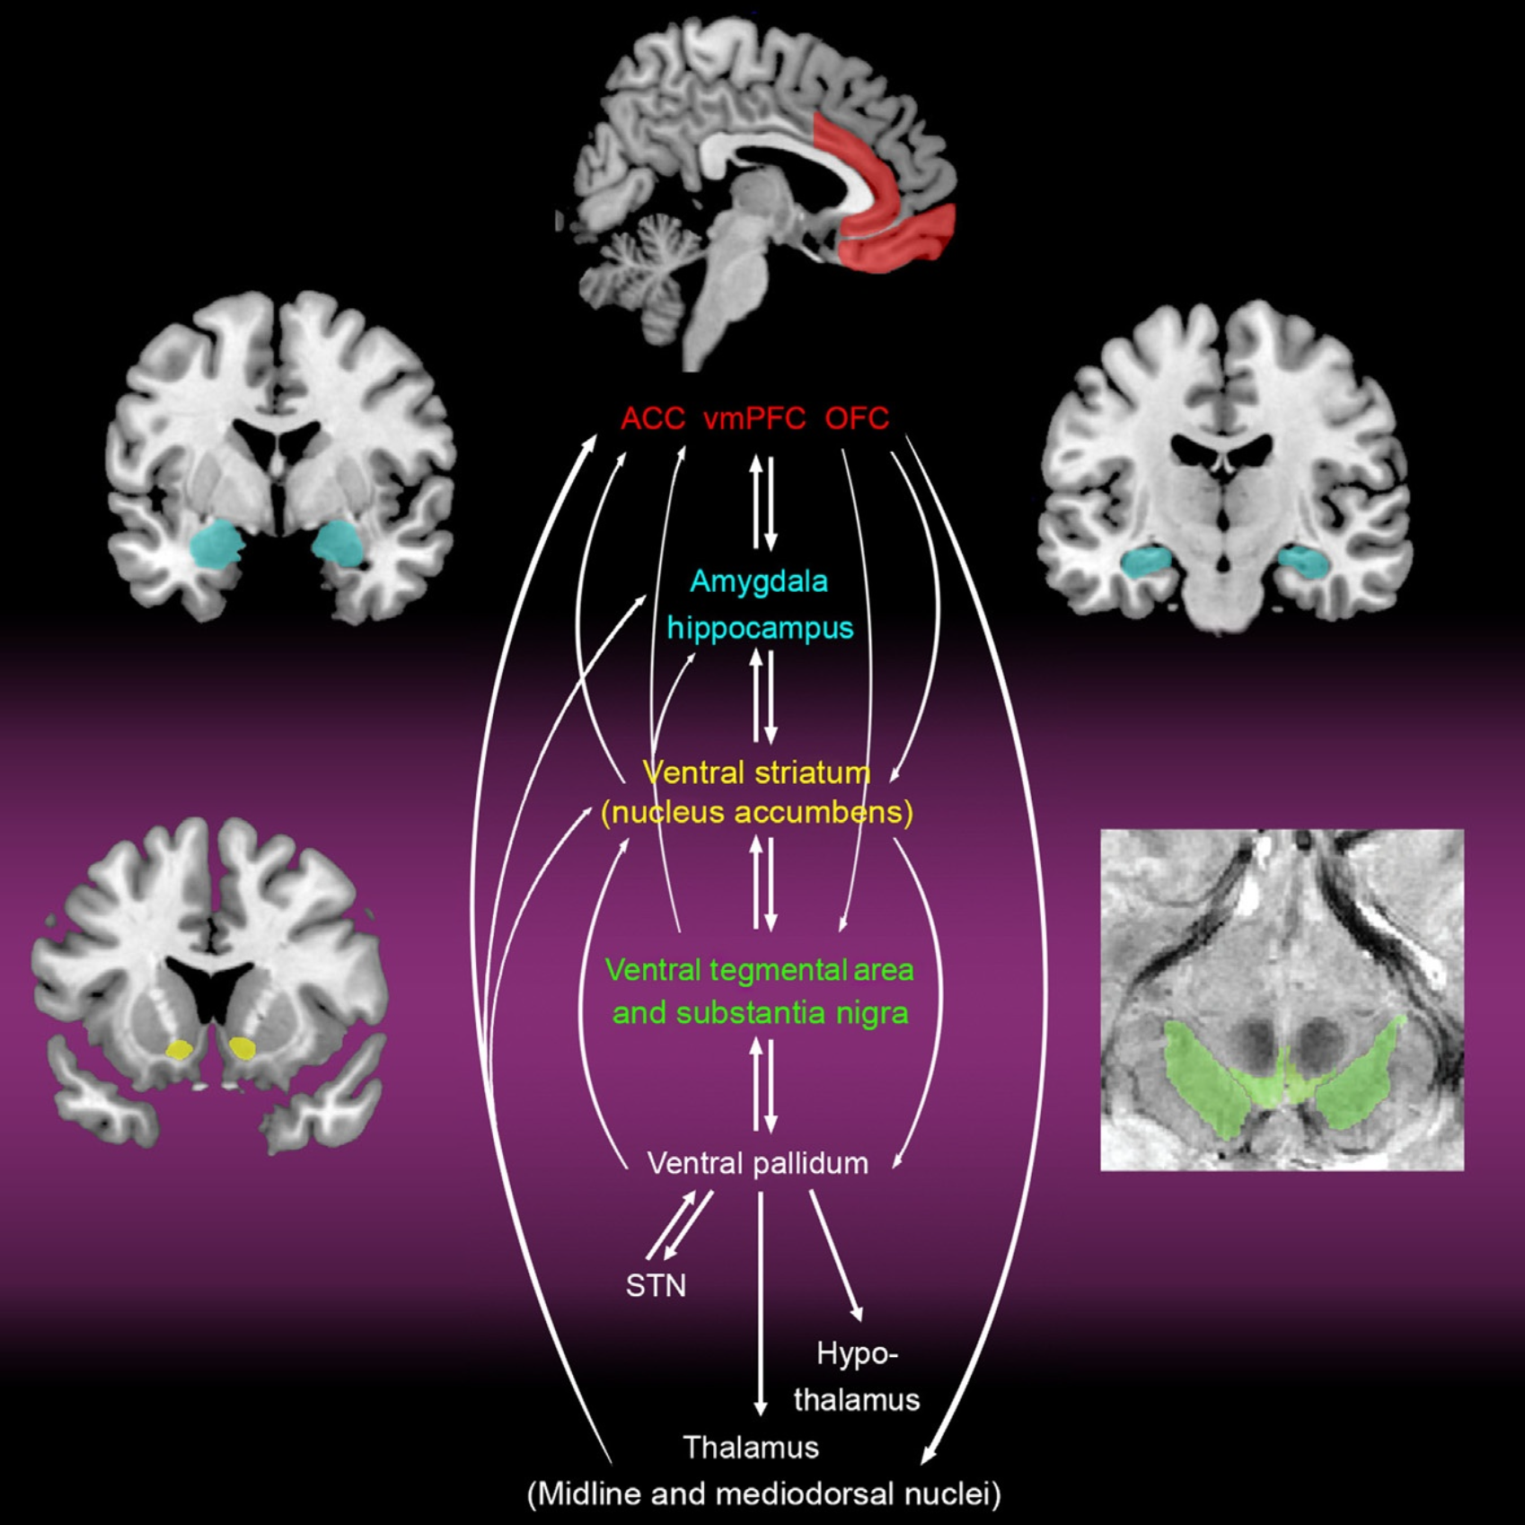
Human reward network overlaps with components of salience network (SN)
The core of the mesocorticolimbic system is formed by basal ganglia nuclei (shaded maroon). Projections from the dopaminergic midbrain originate from the ventral tegmental area and substantia nigra and project to the ventral striatum (nucleus accumbens; yellow), prefrontal cortex (red), and limbic and other subcortical structures (amygdala and hippocampus, blue).
Abbreviations: anterior cingulate cortex (ACC); ventromedial prefrontal cortex (vmPFC); orbitofrontal cortex (OFC); subthalamic nucleus (STN).
Chong, Husain, 2016, Progress in Brain Research, Vol. 229: 389-426

Slide 7
Anhedonia Is Related to Altered Reward Circuitry Response in MDD (“Emotional Locked-in”)
Central
Executive
Network
CEN
dlPFC
PPC
Working memory;
goal-oriented behaviors
decision making
SN
Anhedonia is associated with hyperactivity of the SN at rest and in the context of negative stimuli, as well as a global lack of SN engagement in the context of positive stimuli
Patients with depression have reduced response to exteroceptive stimuli and increased response to interoceptive stimuli
Thalamus
sensory information
Amygdala
affective information
Insula
salience
detection
anticorrelated
NAcc, VTA
reward information
DMN
dACC
action selection
PCC
vmPFC
Self-referential thinking;
internal processes
Salience Network
Motor
Cortices
Default Mode Network
Pisoni et al. Psychiatry Res. 2021:304:114123.
Notes:
dACC, dorsal anterior cingulate cortex; dlPFC, dorsolateral prefrontal cortex; PCC, posterior cingulate cortex; MDD, major depressive disorder; NAcc, nucleus accumbens; SN, salience network; vmPFC, ventromedial prefrontal cortex; VTA, ventral tegmental area.

Slide 8
Depressed Patients Had an Attenuated Ventral Striatal (Nucleus Accumbens) Response to Positive Stimuli
Left Ventral Striatum
(-15, 15, -6)
Right Ventral Striatum
(15, 6, -3)
6
4
2
Mean (±SD) BOLD Response (%)
0
-2
Valence
-4
Negative
Neutral
-6
Positive
Depressed
Subjects
Healthy Comparison Subjects
Depressed
Subjects
Healthy Comparison Subjects
SD=Standard deviation.
Epstein J, et al. Am J Psychiatry. 2006;163:1784–1790.

Slide 9
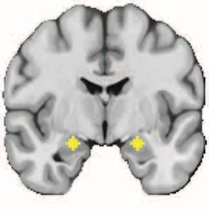

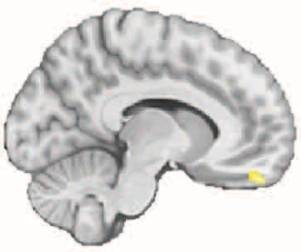
Resilience to MDD: Positive Life Events and Connectivity Between Amygdala and OFC
Bilateral Amygdala Seeds
Functional Connectivity
OFC Connectivity
0.4
12.5
5
4
3
2
1
0.3
LES, No. of Positive Events
10.0
*
*
0.2
7.5
t Value
z Score
0.1
Left OFC
5.0
0
-0.1
2.5
-0.2
0
CTL
CVT
RES
0
0.1
0.2
0.3
*P <.001 compared with CVT
z Score
N = 65 female adolescents participated in the study: n = 20 at high risk in whom depression did not develop (RES), n = 20 at high risk in whom depression developed (CVT), and n = 25 at low risk with no history of psychopathology (CTL).
CVT, converted; CTL, control; OFC, orbitofrontal cortex; RES, resilient.
Fischer et al. JAMA Psychiatry. 2018;75:493.
Notes:
CVT, converted; CTL, control; MDD, major depressive disorder; OFC, orbitofrontal cortex; RES, resilient.

Slide 10
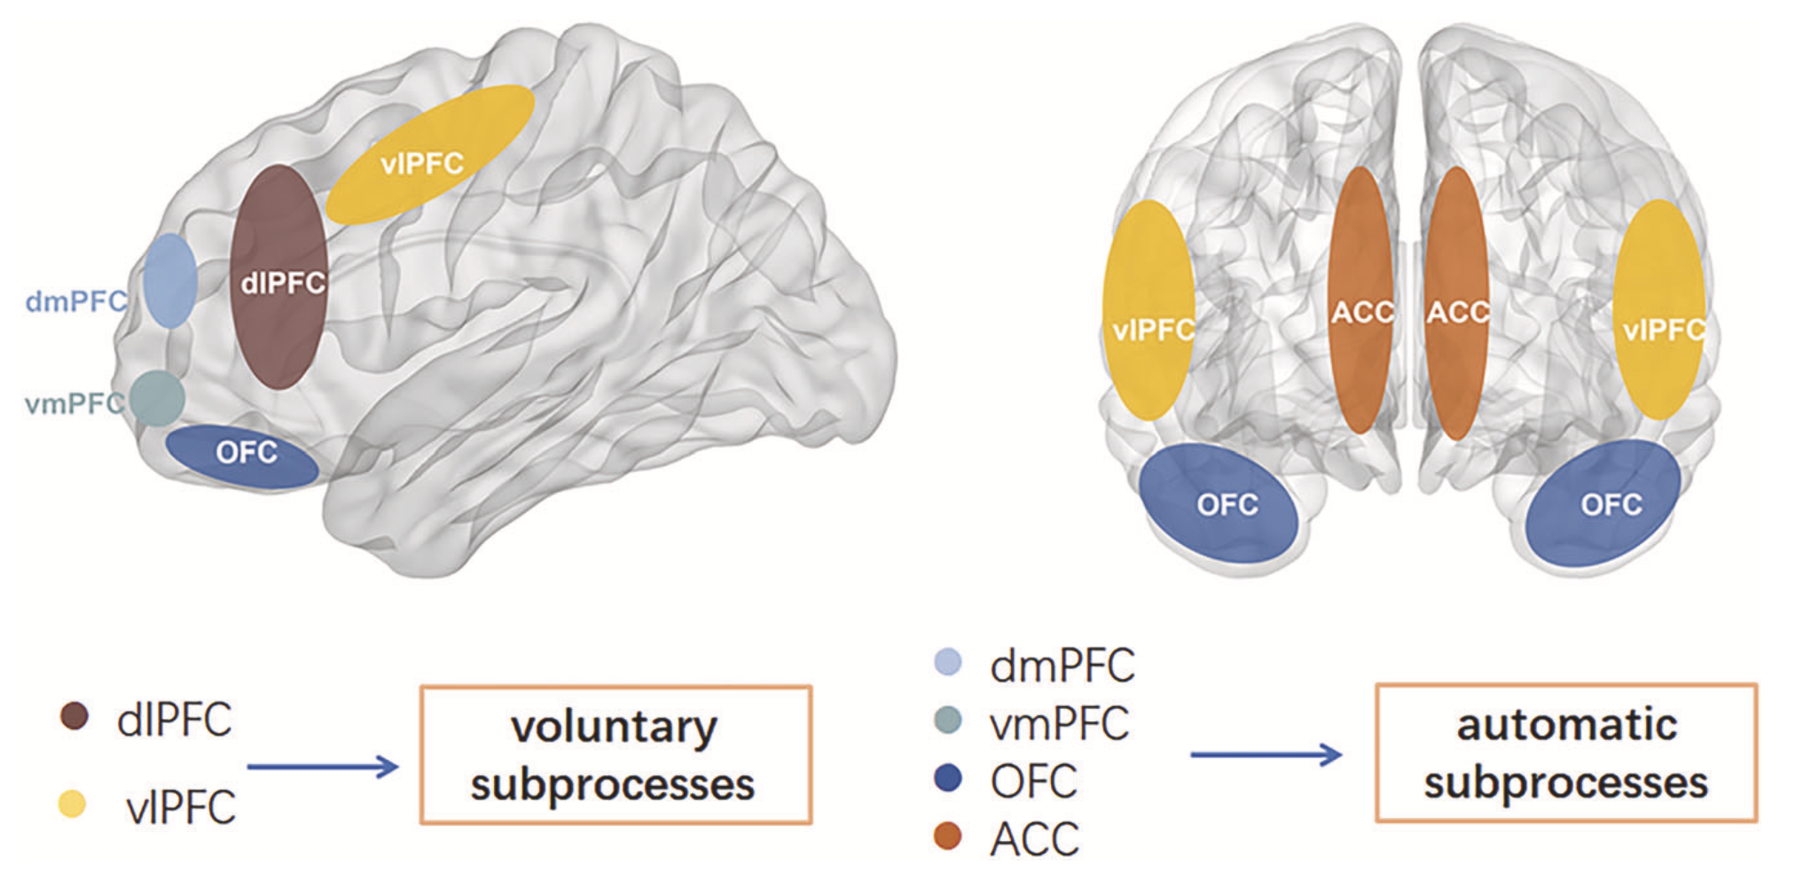
Volitional and automatic regulation of emotion
dlPFC
vlPFC
dlPFC dorsolateral prefrontal cortex, vlPFC ventrolateral prefrontal cortex, dmPFC dorsomedial prefrontal cortex, vmPFC ventromedial prefrontal cortex, OFC orbitofrontal cortex, ACC anterior cingulate cortex.
The lateral prefrontal cortical regions (dlPFC and vlPFC), which develop relatively late and are involved in higher executive functions may subserve voluntary subprocesses. The automatic subprocess includes the area of dmPFC, vmPFC, OFC, ACC, and are involved especially in the control of emotional behaviors.
Bi et al, 2022, Translational Psychiatry,12:143

Slide 11
Central Executive Network, Overlaps With Anatomical Fronto-Parietal Network
Physiologic Condition
Working memory
Attention (sustained)
Decision-making/problem solving
Goal-oriented activity/action planning
Top-down regulation of emotion
PPC
dIPFC
CEN-Associated Symptoms in Mood Disorders
Indecisiveness
Attentional difficulties/loss of focus
Poor working memory
Disorganization
Compromised executive function
Reflective to reactive mode
Inadequate top-down regulation of emotions
Less outwardly oriented
dACC
dmPFC
ITG
CEN is centered on the dorsolateral prefrontal cortex (dlPFC) and posterior parietal cortex (PPC), and also includes the dorsomedial prefrontal cortex (dmPFC), dorsal ACC (dACC), and inferior temporal gyrus (ITG)
Mulders et al. Neurosci Biobehav Rev. 2015;56:330. Menon. Trends Cogn Sci. 2011;15:483. Bär et al. NeuroImage. 2016;134:53.
Dunlop et al. Curr Psychiatry Rep. 2019;21:87. Bi et al. Transl Psychiatry. 2022;12:143.
Notes:
dACC, dorsal ACC; CEN, central executive network; dlPFC, dorsolateral prefrontal cortex; dmPFC, dorsomedial prefrontal cortex; ITG, inferior temporal gyrus; PPC, posterior parietal cortex.

Slide 12
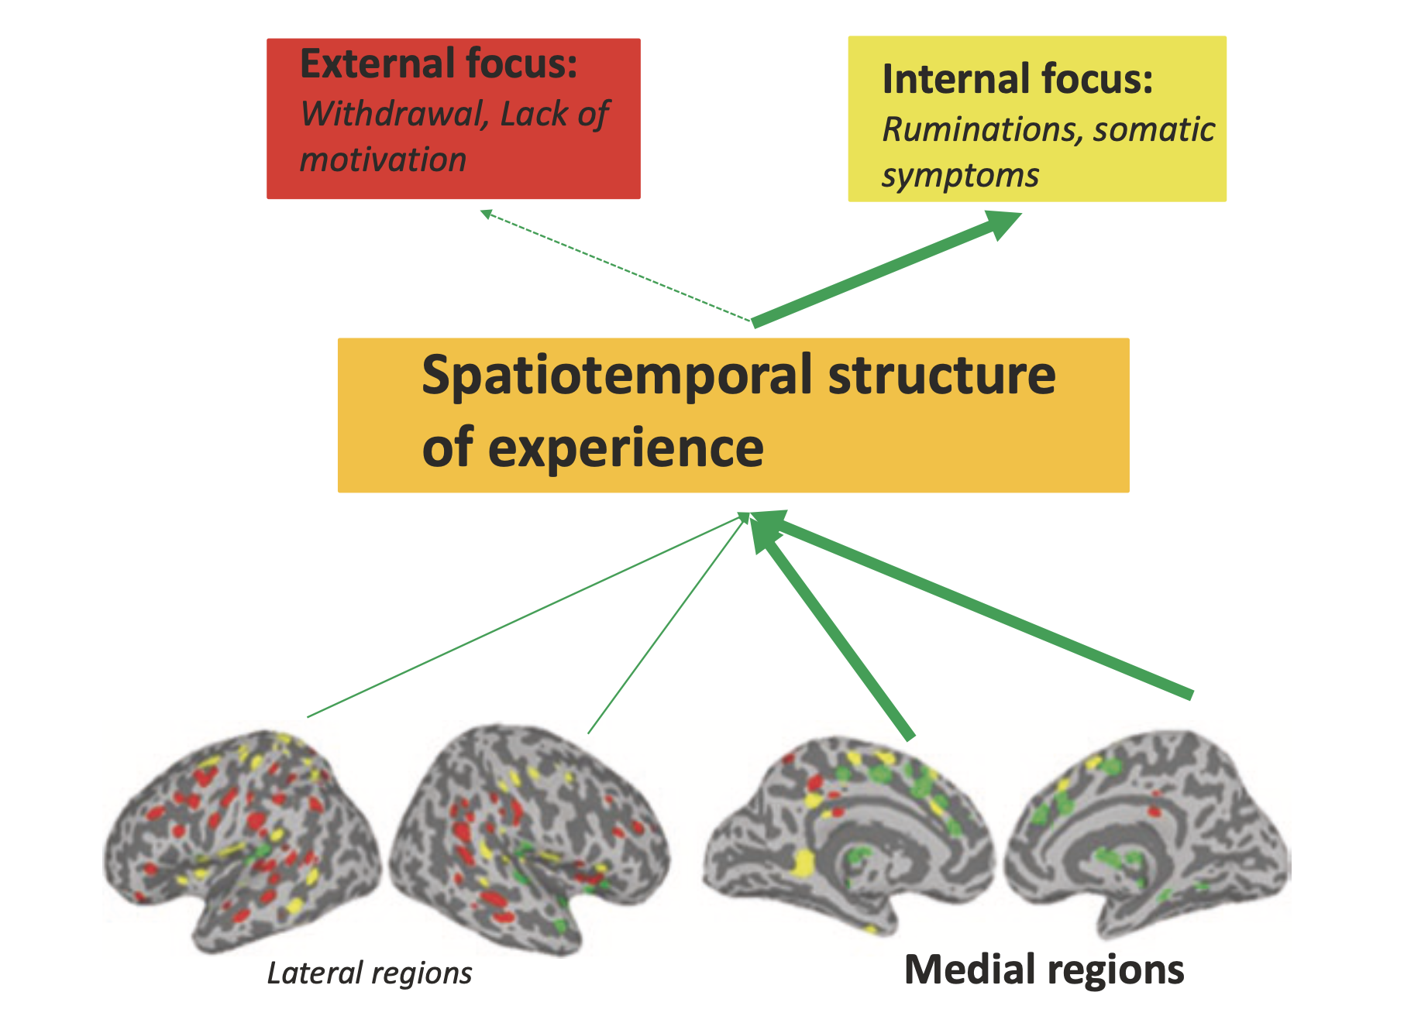
“Inward facing” brain in MDD
The medial prefrontal regions like PACC and VMPFC are core regions of the default mode network (DMN), while lateral prefrontal regions like DLPFC are a part of the central executive network (CEN). The DMN shows functional hyperconnectivity among its regions and especially between anterior and posterior midline regions. In contrast to the regions within the DMN, regions within the CEN show functional hypoconnectivity and also less connected to parietal regions implicated in attention toward the external environment. Abnormal reciprocal modulation between medial/DMN and lateral/CEN prefrontal cortex with their spatial balance tilting abnormally toward the former at the expense of the latter may underpin clinical manifestations of MDD.
PACC= posterior cingulate cortex; VMPFC=ventromedial prefrontal cortex; DLPFC=dorsolateral prefrontal cortex.
Northoff, 2021,Adv Exp Med Biol;1305:71-84

Slide 13
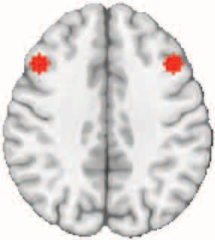
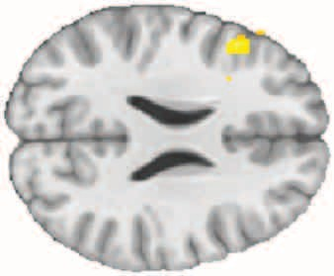
Resilience to MDD: greater connectivity between Executive Control Network regions
Regions of executive control network VLPFC
Bilateral DLPFC seeds
0.8
5
4
3
2
1
a
0.6
z Score
0.4
The longitudinal study of familial risk for depression recruited 190 female adolescents. Participants were followed over the course of adolescence from age 9 through age 18 years. Half of the participants had a mother who had recurrent MDD episodes during the daughter’s lifetime (high risk); the other half had mothers with no history. Report is on N=65 female adolescents participated in the study: 20 at high risk in whom depression did not develop (resilient=RES), 20 at high risk in whom depression developed (converted=CVT), and 25 at low risk with no history of psychopathology (control=CTL).
DLPFC, dorsolateral prefrontal cortex; VLPFC, ventrolateral prefrontal cortex. a P < .001 compared with CVT.
0
–0.2
CTL
CVT
RES
Fischer et al, 2018, JAMA Psychiatry.;75(5):493-502

Slide 14
Default Mode Network
Physiologic Condition
Self-reflection/self-monitoring
Processing social information
Planning
Reminiscing/episodic memory
Creativity
Theory-of-mind
Autobiographical memory retrieval
Spatial navigation
PCC/PCU
LTC
mPFC
DMN-Associated Symptoms in Mood Disorders
Rumination/inward orientation
Mind wandering
Worries
Deficits in goal-directed activity
Social dysfunction
Deficient self-monitoring
Less stable sense of self
Compromised autobiographical memory and theory-of mind function?
Hip
DMN consists of 2 core regions: medial prefrontal cortex (mPFC) and posterior cingulate cortex/precuneus (PCC/PCU), and the inferior parietal lobule (IPL)
The lateral temporal cortex (LTC) and the hippocampal formation (Hip) are related to the DMN, but constitute a subsystem within the DMN
Mulders et al. Neurosci Biobehav Rev. 2015;56:330. Menon. Trends Cogn Sci. 2011;15:483. Bär et al. NeuroImage. 2016;134:53.
Dunlop et al. Curr Psychiatry Rep. 2019;21:87. Bi et al. Transl Psychiatry. 2022;12:143.
Notes:
DMN, default mode network; Hip, hippocampal formation; LTC, lateral temporal cortex; mPFC, medial prefrontal cortex; PCC/Pcu, posterior cingulate cortex/precuneus.

Slide 15
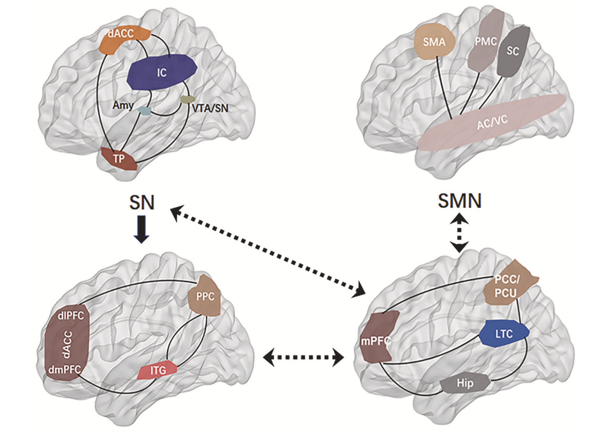
Adaptive and maladaptive interactions between functional networks
Sensory and limbic inputs
The salience network (SN) plays a key role in switching between the default mode network (DMN) and central executive network (CEN). Abnormalities of the SN could lead to weak salience mapping and give rise to dysfunctions of the CEN and DMN. The DMN/SMN balance favored the DMN in MDE and the SMN in mania with bipolar disorder.
CEN
DMN
Bi et al, 2022, Translational Psychiatry,12:143

Slide 16
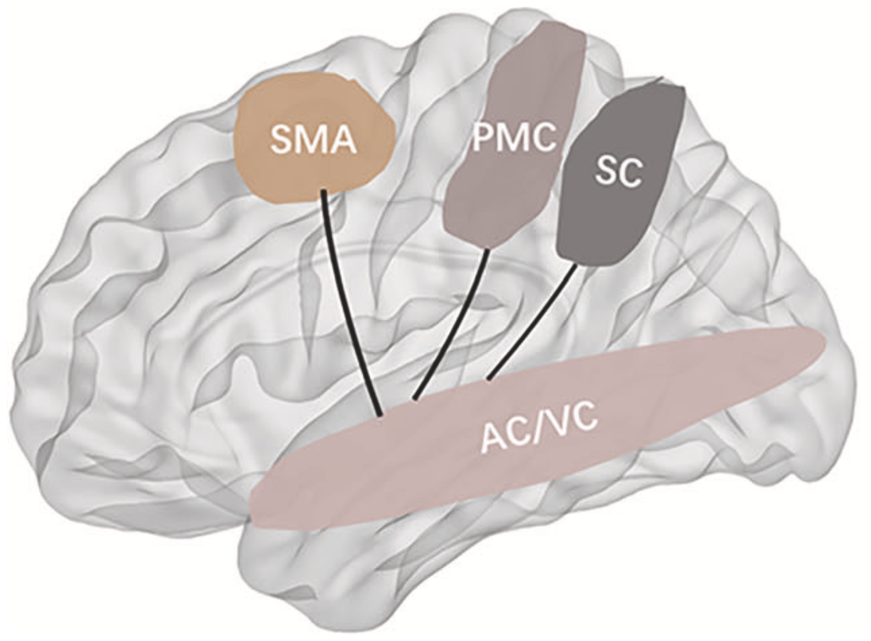
Somatomotor/sensorimotor network (SMN)
SMN-related symptoms of mood disorders (psychomotor disturbance has been added to RDoC):
Psychomotor agitation/excitation/hyperactivity
Psychomotor retardation/inhibition/fatigue (in MDD: slow speech, movement initiation, loss of facial expression)
Sensory hyperacuity/hypersensitivity (in MDD: increased exteroceptive tolerance, decreased interoceptive tolerance)
Sensory disturbance/distortion
Emotional lability/reactivity
Manic/Hypomamic symptoms/psychosis
Impulsivity
Misinterpretation of interoceptive stimuli/pain
Somatic symptoms of depression?
Severity of depression
SMN—which comprises the middle cingulate cortex (MCC), dorsal striatum, ventral nuclei of thalamus and postcentral gyrus, (somatosensory cortex-SC), premotor (PMC) and supplemental motor areas (SMAs)—is involved in sensory processing and motor functions. Auditory and visual cortices (AC/VC) are sometimes included.
Bär et al. 2016, NeuroImage 134: 53–63; Conio B et al., 2020, Mol Psychiatry, 25(1): 82-93; Javaheripour et al, 2021, Translational Psychiatry, 11:511; Liu et al, 2021, Brain Research, 1750: 147143; Ray et al, 2021, PNAS Vol. 118 No. 40 e2105730118 ; Bi et al, 2022, Translational Psychiatry,12:143

Slide 17
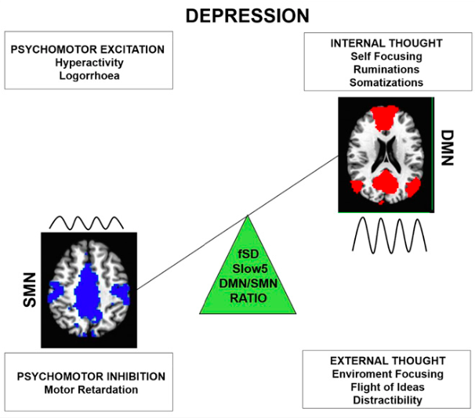
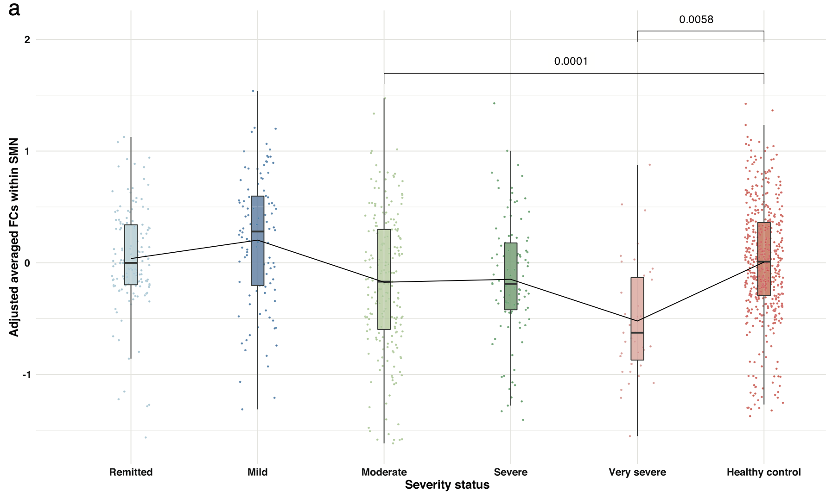
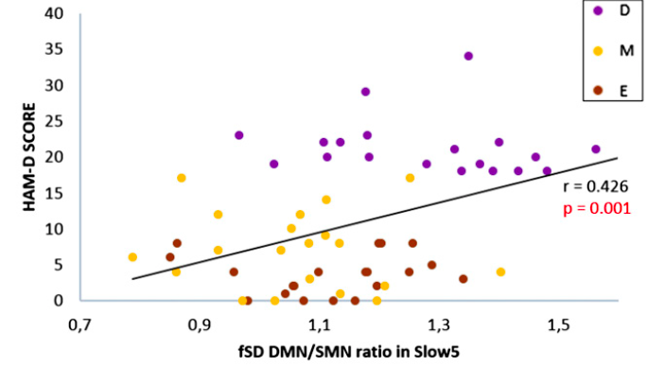
Hypoconnectivity within sensory-motor network (SMN) may be one of the most stable functional markers of depression
Adjusted averaged functional connectivity within SMN
Moderate depression
Controls
Very severe depression
N=606 MDD patients (age: 35.8 ± 11.9 y.o.; females: 60.7%) and n=476 healthy participants (age: 33.3 ± 11.0 y.o.; females: 56.7%
Javaheripour et al, 2021, Translational Psychiatry,11:511; Martino et al, 2016, PNAS, . 113 (17): 4824–4829

Slide 18
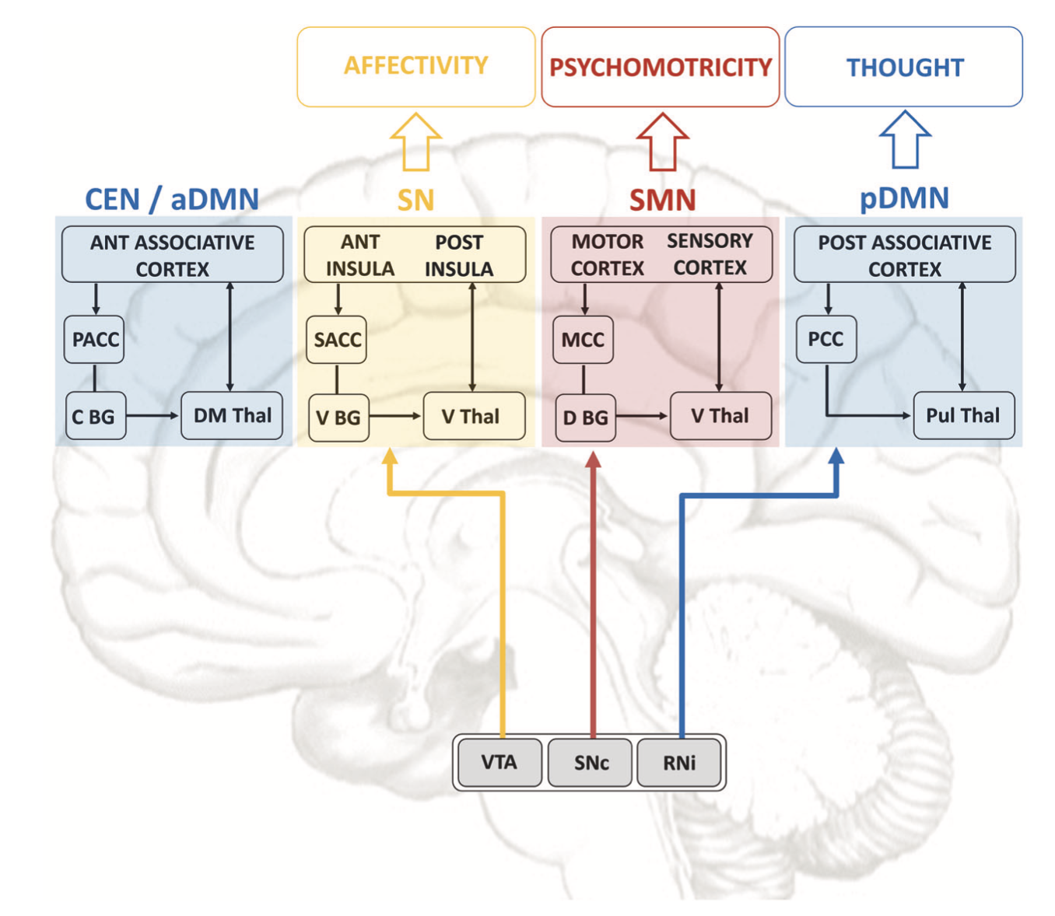
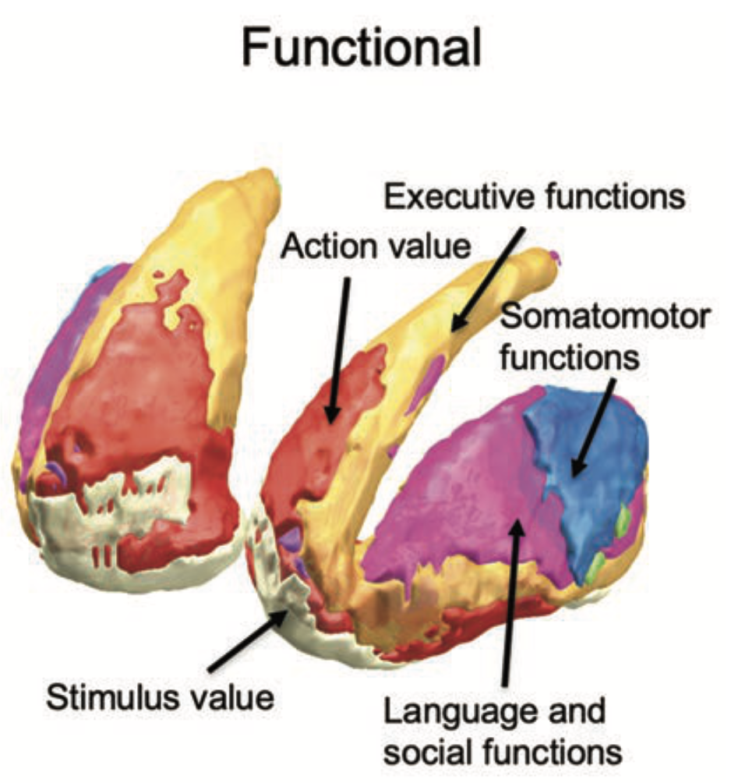
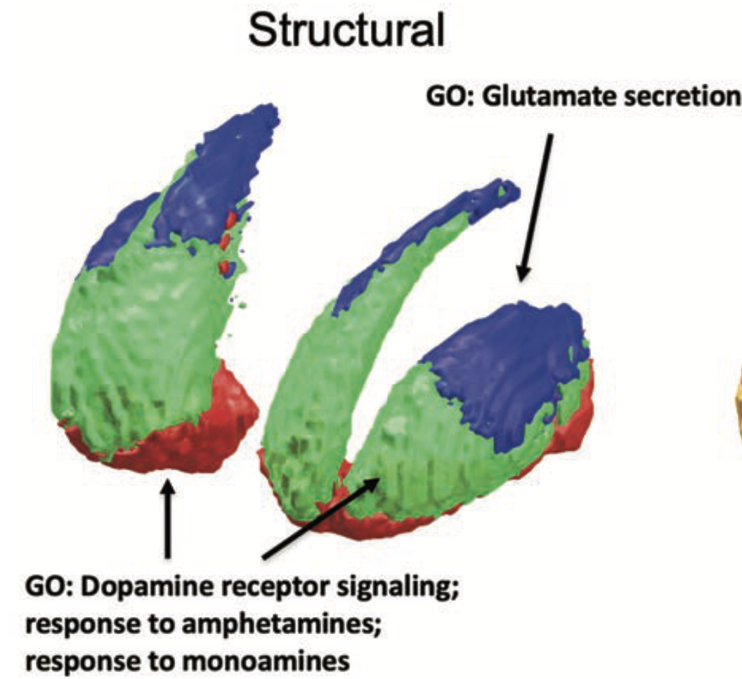
Mood disorders: symptoms, functional networks and neurotransmitters
COGNITIVE/EXECUTIVE
Sensorimotor
Limbic
Associative
LC
Abbreviations: SMN sensorimotor network, SN salience network, aDMN anterior default-mode network, pDMN posterior default-mode network, CEN central executive network, PACC perigenual anterior cingulate cortex, SACC supragenual anterior cingulate cortex, MCC middle cingulate cortex, PCC posterior cingulate cortex, C BG central basal ganglia, V BG ventral basal ganglia, D BG dorsal basal ganglia, DM Thal dorsomedial nucleus of thalamus, V Thal ventral nuclei of thalamus, Pul Thal pulvinar nucleus of thalamus, VTA, ventral tegmental area, SNc substantia nigra, RNi raphe nuclei.
NE
5HT
DA
Adapted from: Martino, Magioncalda, 2021, Molecular Psychiatry, aop; van der Brink et al, 2018, Journal of Neuroscience, 38(34):7476 –7491; McCutcheon et al, 2019, Trends in Neurosciences; 42(3): 205-220; Basile et al, 2021, European Journal of Histochemistry; 65(s1):3284

Slide 19
Motor, Associative, and Limbic Divisions of Cortico-Striatal-Thalamo-Cortical Loop: An Updating System
Sensorimotor and premotor cotex
Dorsolateral prefrontal and lateral orbitofrontal cortex
Limbic and paralimbic cortex, hippocampus and amygdala
SMN
CEN
SN
Direct pathway
Indirect pathway
GABA
Glutamate
Dopamine
Cortex
Cn
Cn
Thalamus
Thalamus
Thalamus
Thalamus
GPe
Striatum
D2-ENK
D1-DYN
Put
Put
Put
GPe
GPe
GPe
GPi
GPi
GPi
STN
STN
STN
STN
SNc
Gpi/SNr
(a) Motor circuit
(b) Associative circuit
(c) Limbic circuit
Lapidus et al. Neurotherapeutics. 2014;11:485. Basile et al. Eur J Histochem. 2021;65:3284.
Notes:
Cn, caudate nucleus; CEN, central executive network; D2-ENK, dopamine receptor D2 and enkephalin; D1-DYN, dopamine receptor D1, substance P and dynorphin; GPi, globus pallidus pars interna; GPe, globus pallidus pars externa; Put, putamen; SMN, sensorimotor network; STN, subthalamic nucleus; SN, salience network; SNr, substantia nigra pars reticulata; SNc, substantia nigra pars compacta.

Slide 20
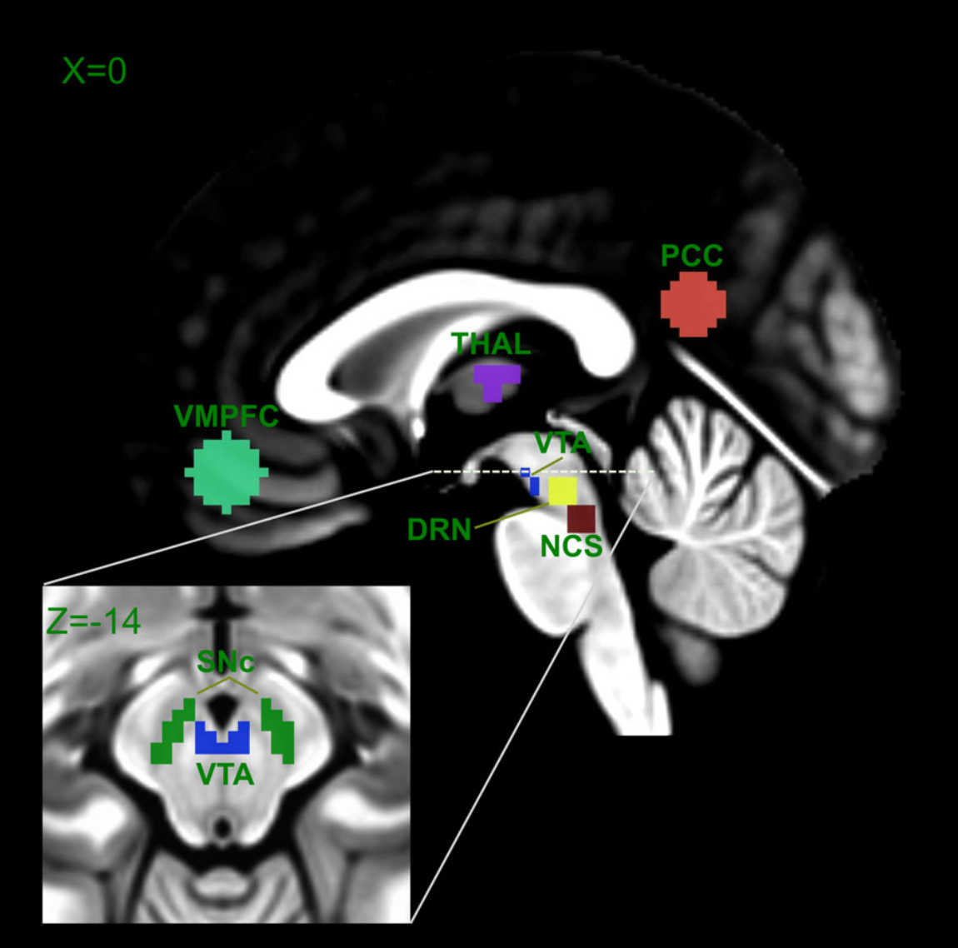
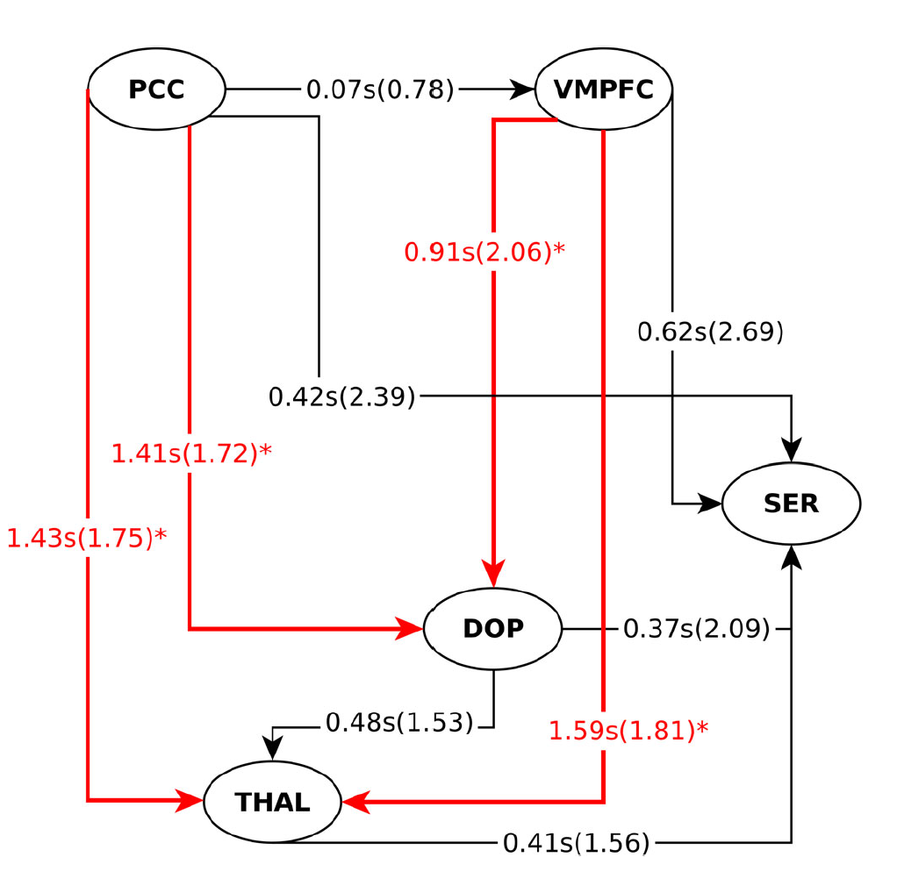
DMN in a top-down fashion modulates 5HT and DA
The number represents the averaged relative latency in seconds between the two corresponding regions, whereas the value in parentheses their respective standard deviation. *p < .05
Ventromedial prefrontal cortex (VMPFC), thalamus (THAL), posterior cingulate cortex (PCC), ventral tegmental area (VTA), substantia nigra (SNc), dorsal raphe nucleus (DRN), and nucleus centralis superior (NCS, same as MNR); SER (serotonin); DOP (dopamine).
DE LA CRUZ et al, 2021, Hum Brain Mapp.;42:811–823.

Slide 21
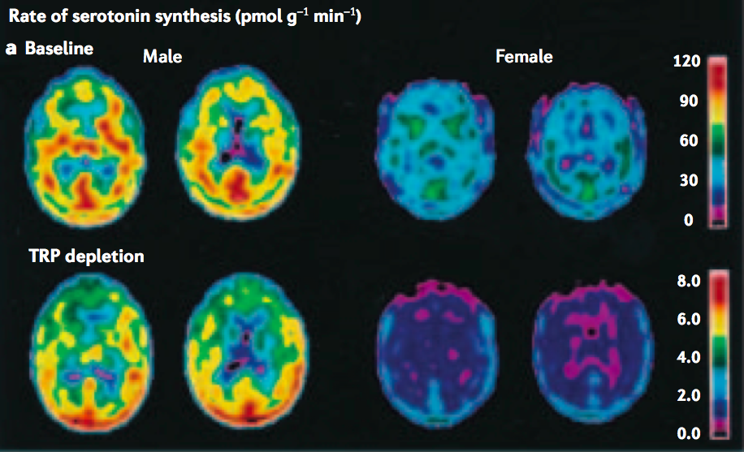
Different rate of serotonin (5HT) synthesis in women and men
The mean rate of 5HT synthesis was found to be 52% higher in males than in females.
Nishizawa and colleagues63 used positron emission tomography (PET) to assess serotonin synthesis rates in healthy men and women. a | Images show PET scans taken from a representative male and female subject. Images are shown before and after depletion of plasma tryptophan. The mean rate of synthesis was found to be 52% higher in males than in females.
Nishizawa and colleagues used positron emission tomography (PET) to assess serotonin synthesis rates in healthy men and women. Images show PET scans taken from a representative male and female subject. Images are shown before and after depletion of plasma tryptophan.
Nishizawa, S. et al. 1997, Proc. Natl Acad. Sci. USA 94, 5308–5313.

Slide 22
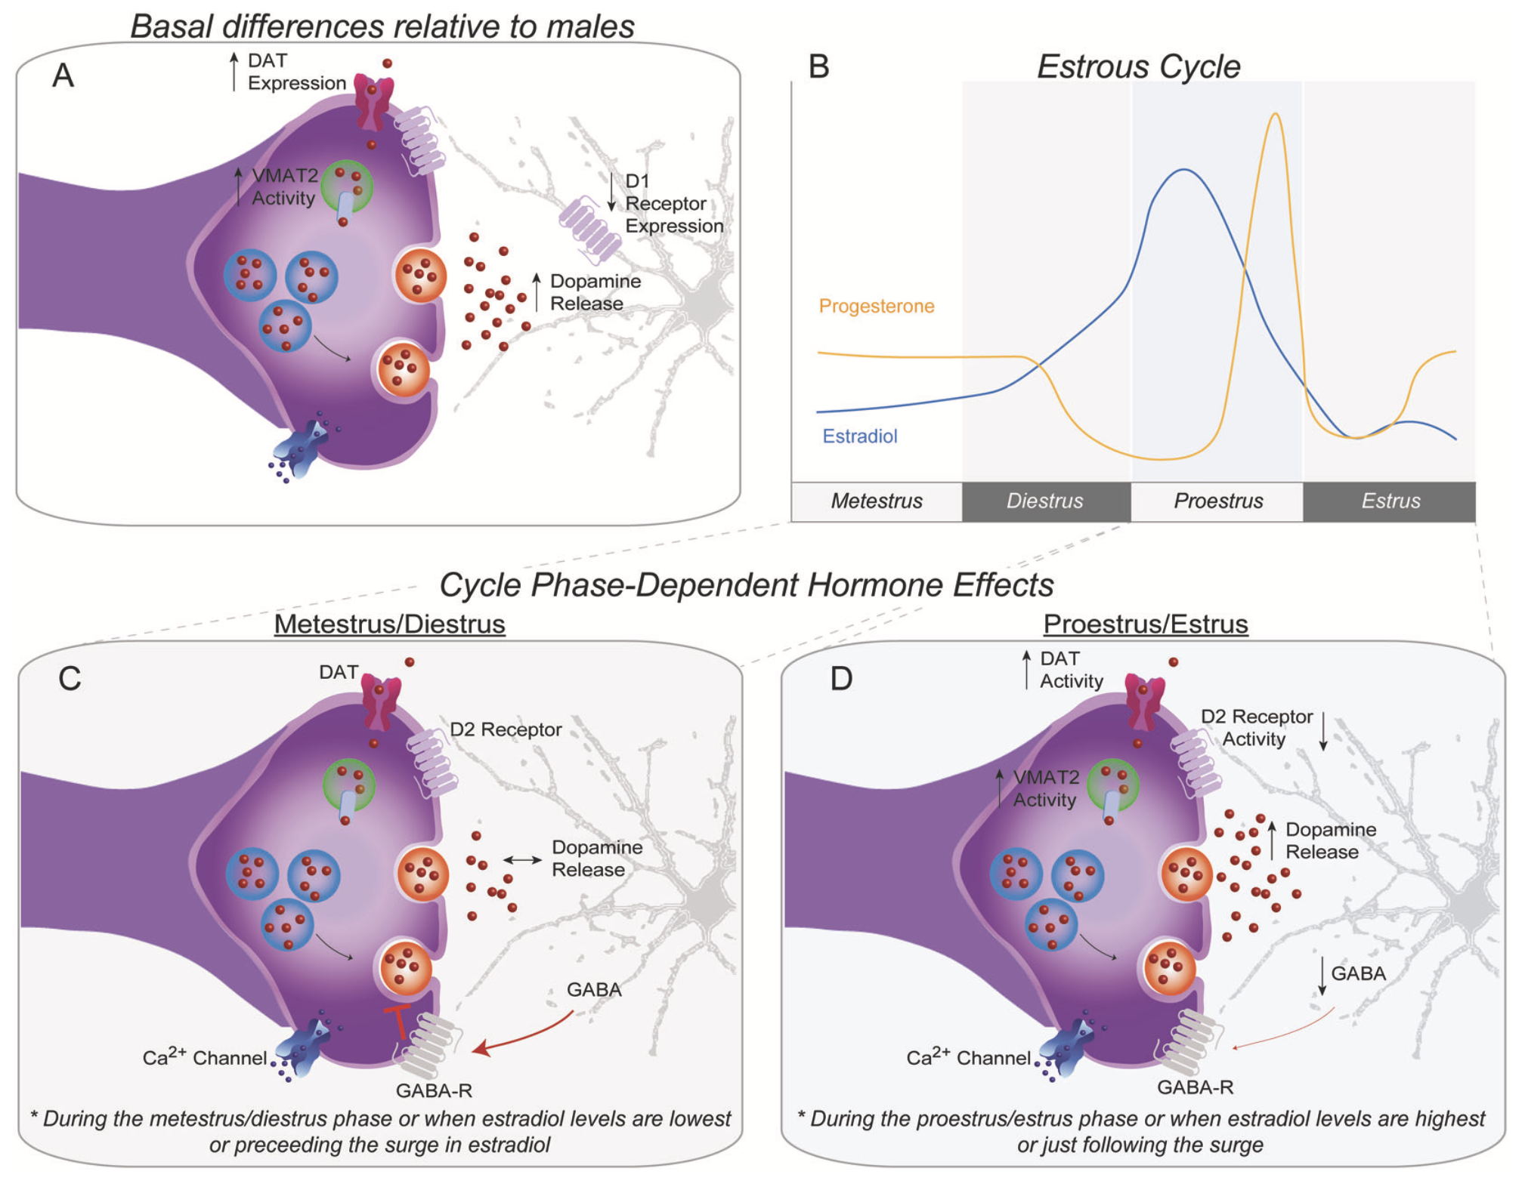
Sex differences in dopamine release
Sex differences in regulation of dopamine release at dopamine terminals in the striatum.
During proestrus/estrus, when hormone levels are at their highest, dopamine release is enhanced via increases in active release, reduced D2 autoregulation, increased DAT and VMAT2 activity, and reduced GABA release and associated receptor activation. Basal differences in females relative to males. Females show lower expression of D1 receptors on GABAergic MSNs as well higher DAT expression and increased VMAT2 activity, indicating greater regulation of dopamine release and reuptake. b Estradiol (E2) and progesterone are known to regulate dopamine release in striatal brain regions. Their levels are dependent on the phase of the estrous cycle in intact, cycling females.
DA
DA
GABA
Zachry et al, 2021, Neuropsychopharmacology, 46:491–499

Slide 23
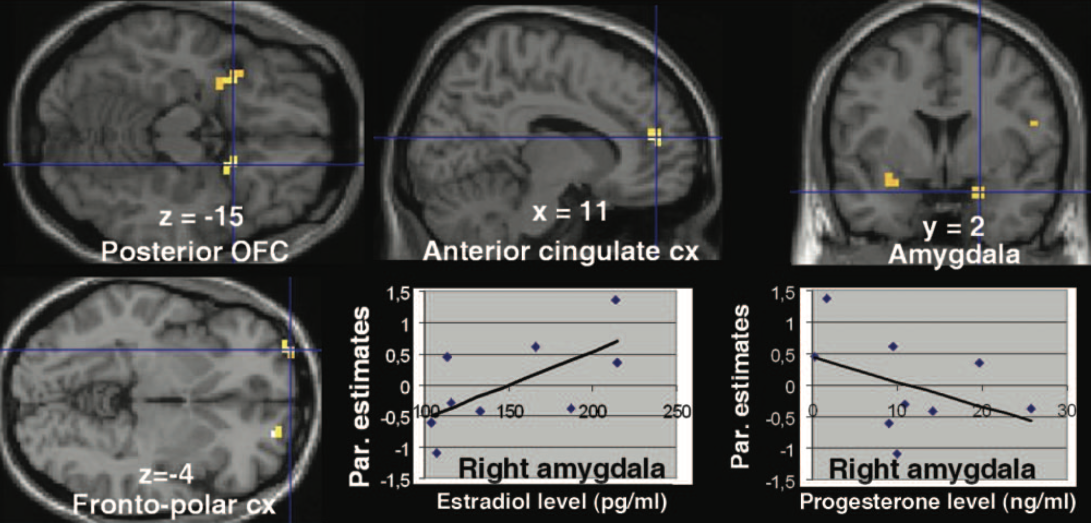
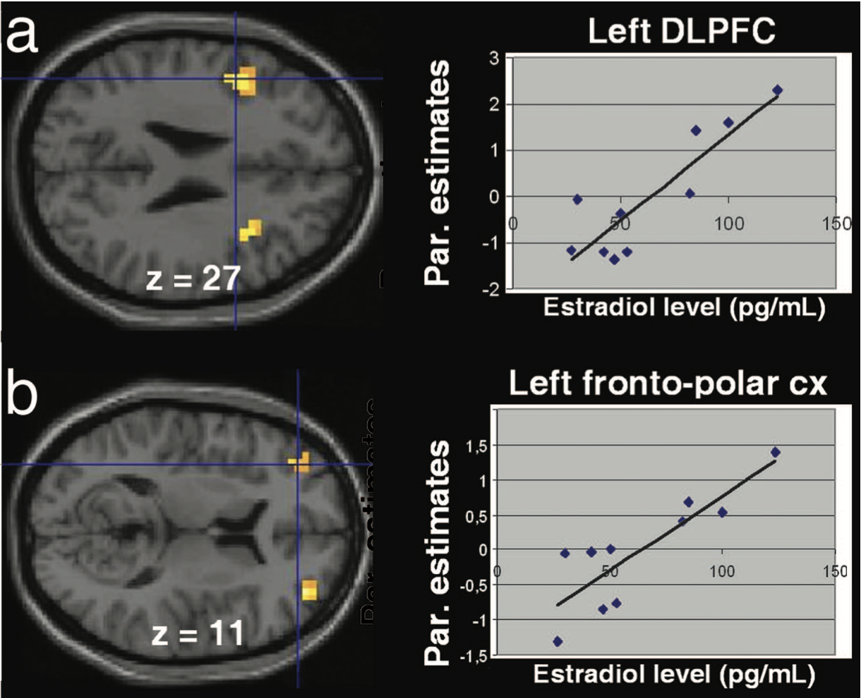
Modulation of SN and CEN during menstrual cycle
SN (uncertain rewards)
During the midfollicular phase (days 4 – 8 after onset of menses) women anticipating uncertain rewards activated the orbitofrontal cortex and amygdala more than during the luteal phase (6–10 days after luteinizing hormone surge). At the time of reward delivery, women in the follicular phase activated the midbrain, striatum, and left fronto-polar cortex more than during the luteal phase. These data demonstrate augmented reactivity of the reward system in women during the midfollicular phase when estrogen is unopposed by progesterone.
CEN
Dreher et al, 2007, PNAS, vol. 104 (7): 2465–2470

Slide 24
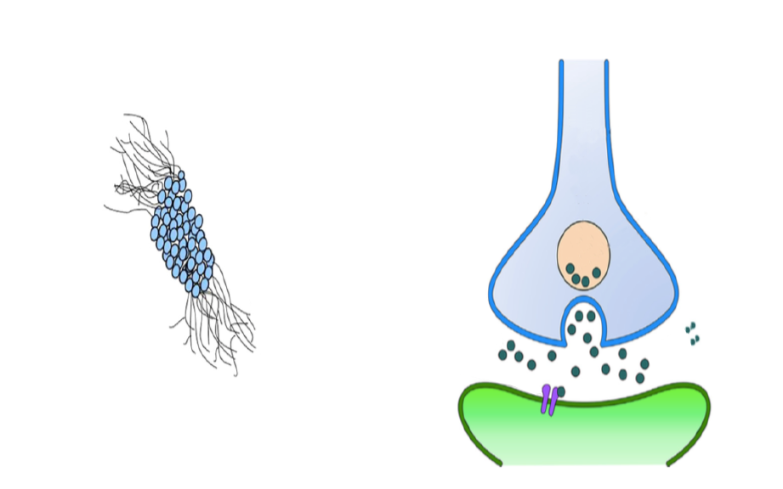
Gender Differences in Norepinephrine Transmission
LC is virtually the only source of NE neurons in human cortex and hippocampus
CeA, BNST
Estrogen increases TH
Females have
longer LC dendrites
Tyrosine
DL Peri-LC
TH
DOPA
LC Core
DA
Estrogen increases DBH
Estrogen
increases
NE levels
DA
DBH
NE
Estrogen
decreases
COMT
Females have
more NE neurons
VM Peri-LC
Estrogen
reduces
adrenergic
receptors
COMT
D
Bar, PGi
NTS, PAG
M
Structural sex differences in the LC can bias females towards increased arousal in response to emotional events (LC size is 15,700 neurons in men and 18,300 neurons in women). Estrogen can increase NE in LC target regions by enhancing the capacity for NE synthesis, while reducing NE degradation, potentially leading to overarousal.
LC = locus coeruleus; NE = norepinephrine.
Bangasser DA, et al. Brain Res. 2016;1641(Pt B):177-188.

Slide 25
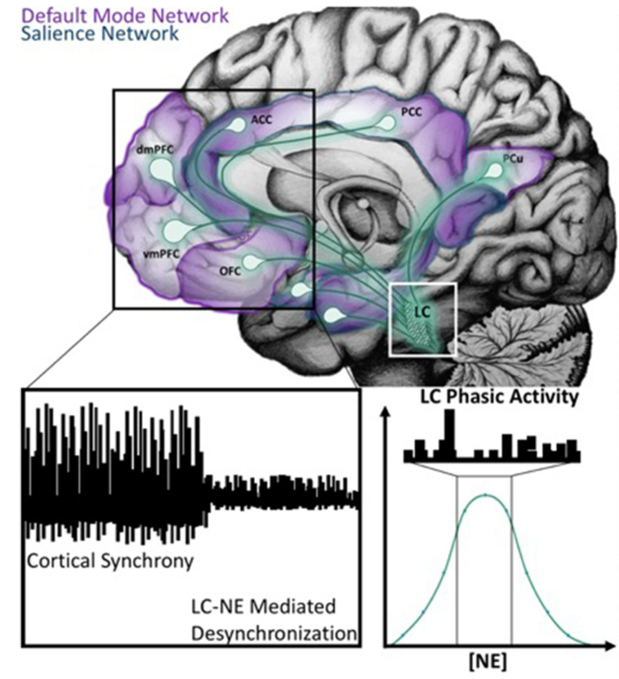
Locus coeruleus (LC) projections to DMN and SN related areas
Novel stimuli or unexpected events results in a brief cortical desynchronization and is thought to arise from phasic burst firing of the LC. The Glutamate Amplifies Noradrenergic Effects Theory asserts that glutamate and norepinephrine work together at “hot spots” to expedite signals from neuronal ensembles that represent salient information.
Default Mode Network (DMN),includes the ventral medial prefrontal cortex (vMPFC), posterior cingulate cortex (PCC), precuneus (pCu), inferior parietal lobe (IPL), lateral temporal cortex (LTC), the dorsal medial prefrontal cortex (dMPFC), and the hippocampal formation. Salience Network (SN) includes anterior insula (aINS) dorsal anterior cingulate cortex (dACC), amygdala, and ventral tegmental areas.
Ross and Van Bockstaele , 2021, Frontiers in Psychiatry, Vol. 11, Article 601519

Slide 26
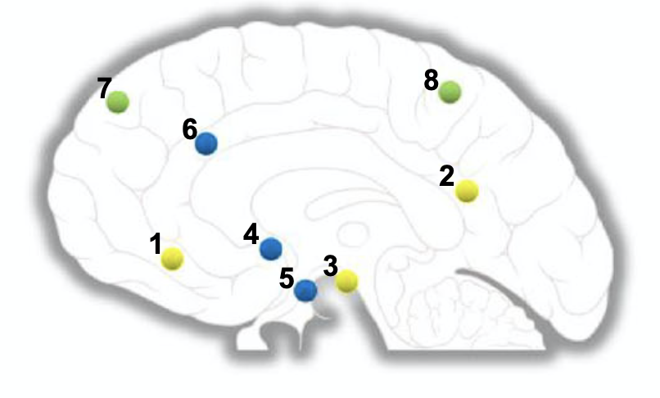
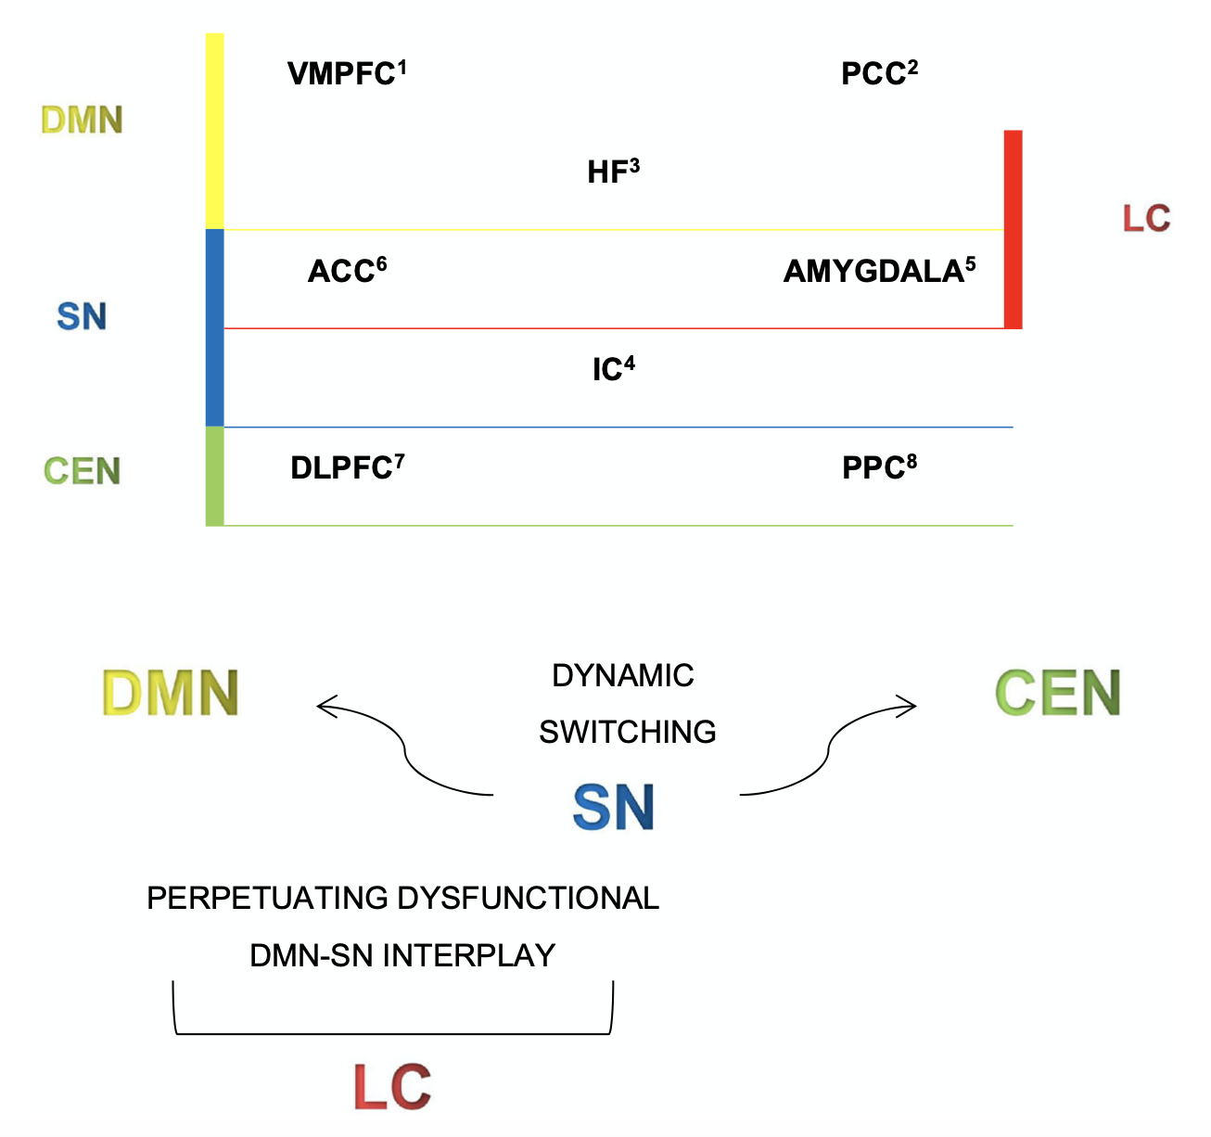
LC activation and arousal regulate functional network dynamic
DLPFC
PPC
ACC
PCC
VMPFC
IC
HF
AMYG
Abbreviations: DMN, default mode network; SN, salience network; CEN, central executive network; LC, limbic circuit; VMPFC, ventromedial prefrontal cortex; PCC, posterior parietal cortex; HF, hippocampal formation; ACC, anterior cingulate cortex; IC, insular cortex; DLPFC, dorsolateral prefrontal cortex; PCC, posterior cingulate cortex
Schiel et al, 2020, Current Psychiatry Reports; 22: 44

Slide 27
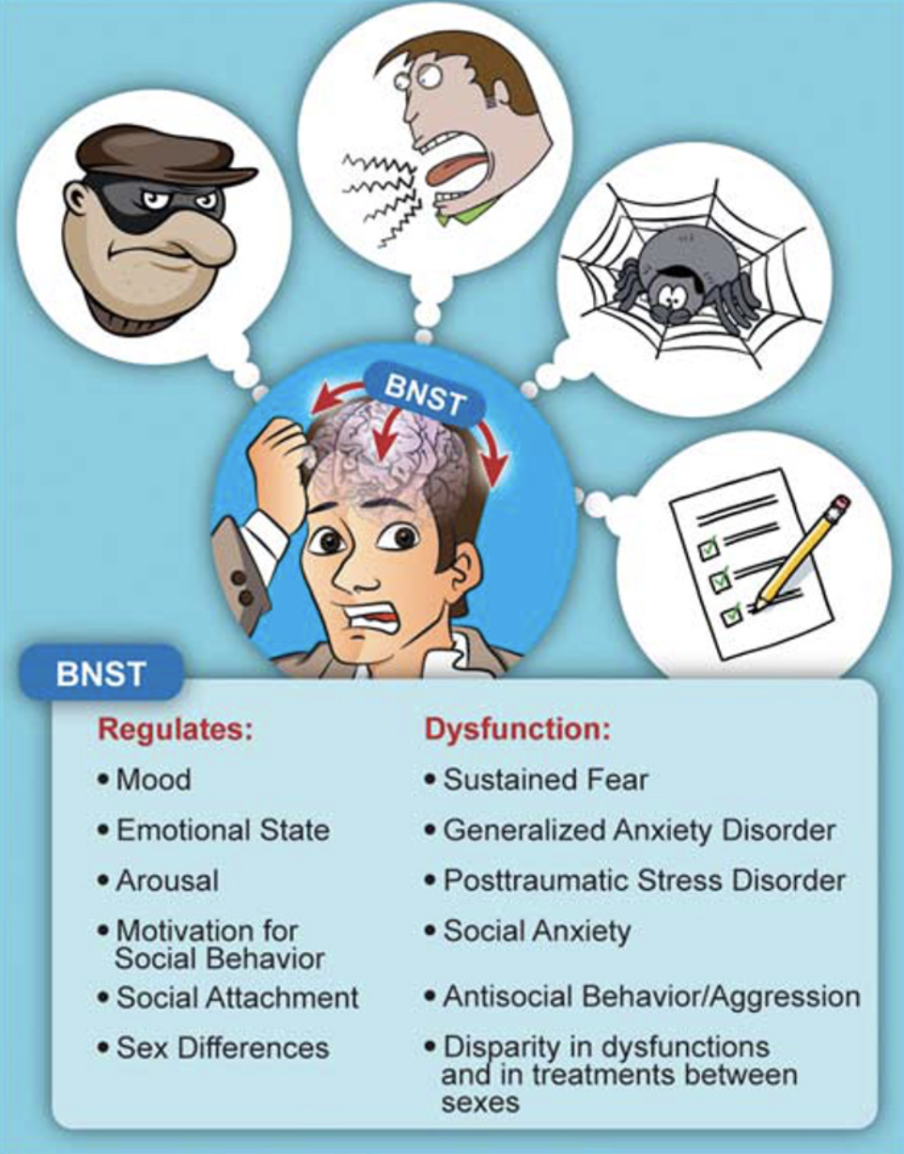
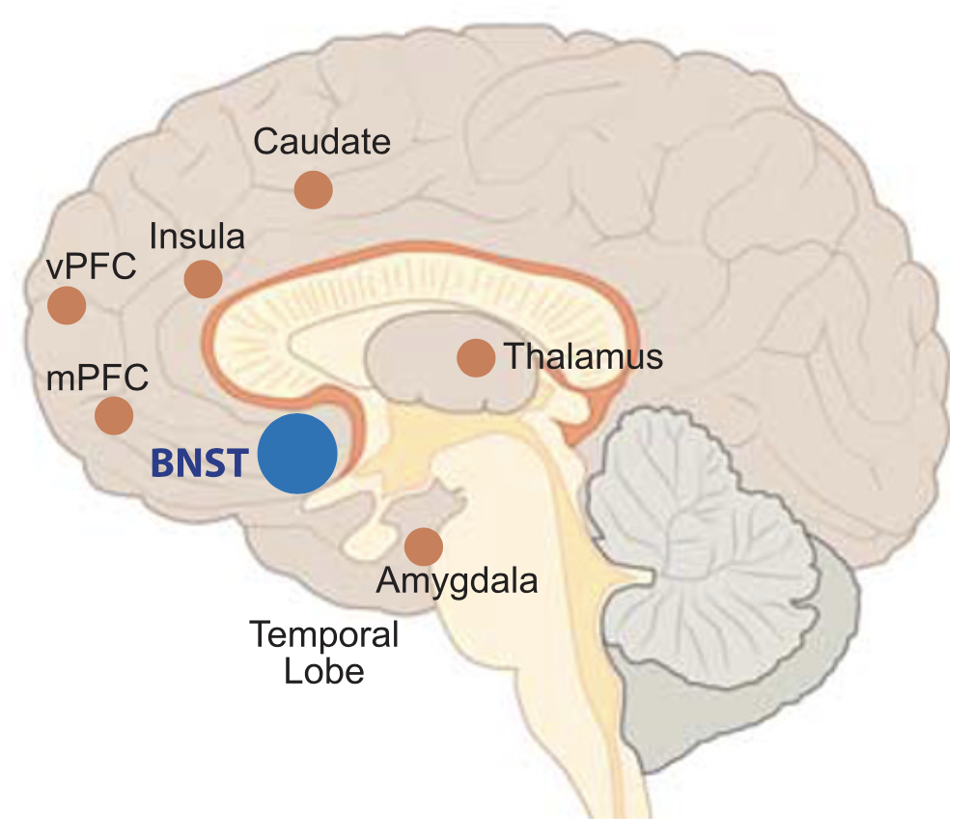
Hidden key to psychiatric disorders: functional connections of human bed nucleus of the stria terminalis (BNST) and regulation of arousal
mPFC and vPFC, medial and ventral prefrontal cortex
Lebow and Chen, 2016, Molecular Psychiatry,21: 450–463

Slide 28
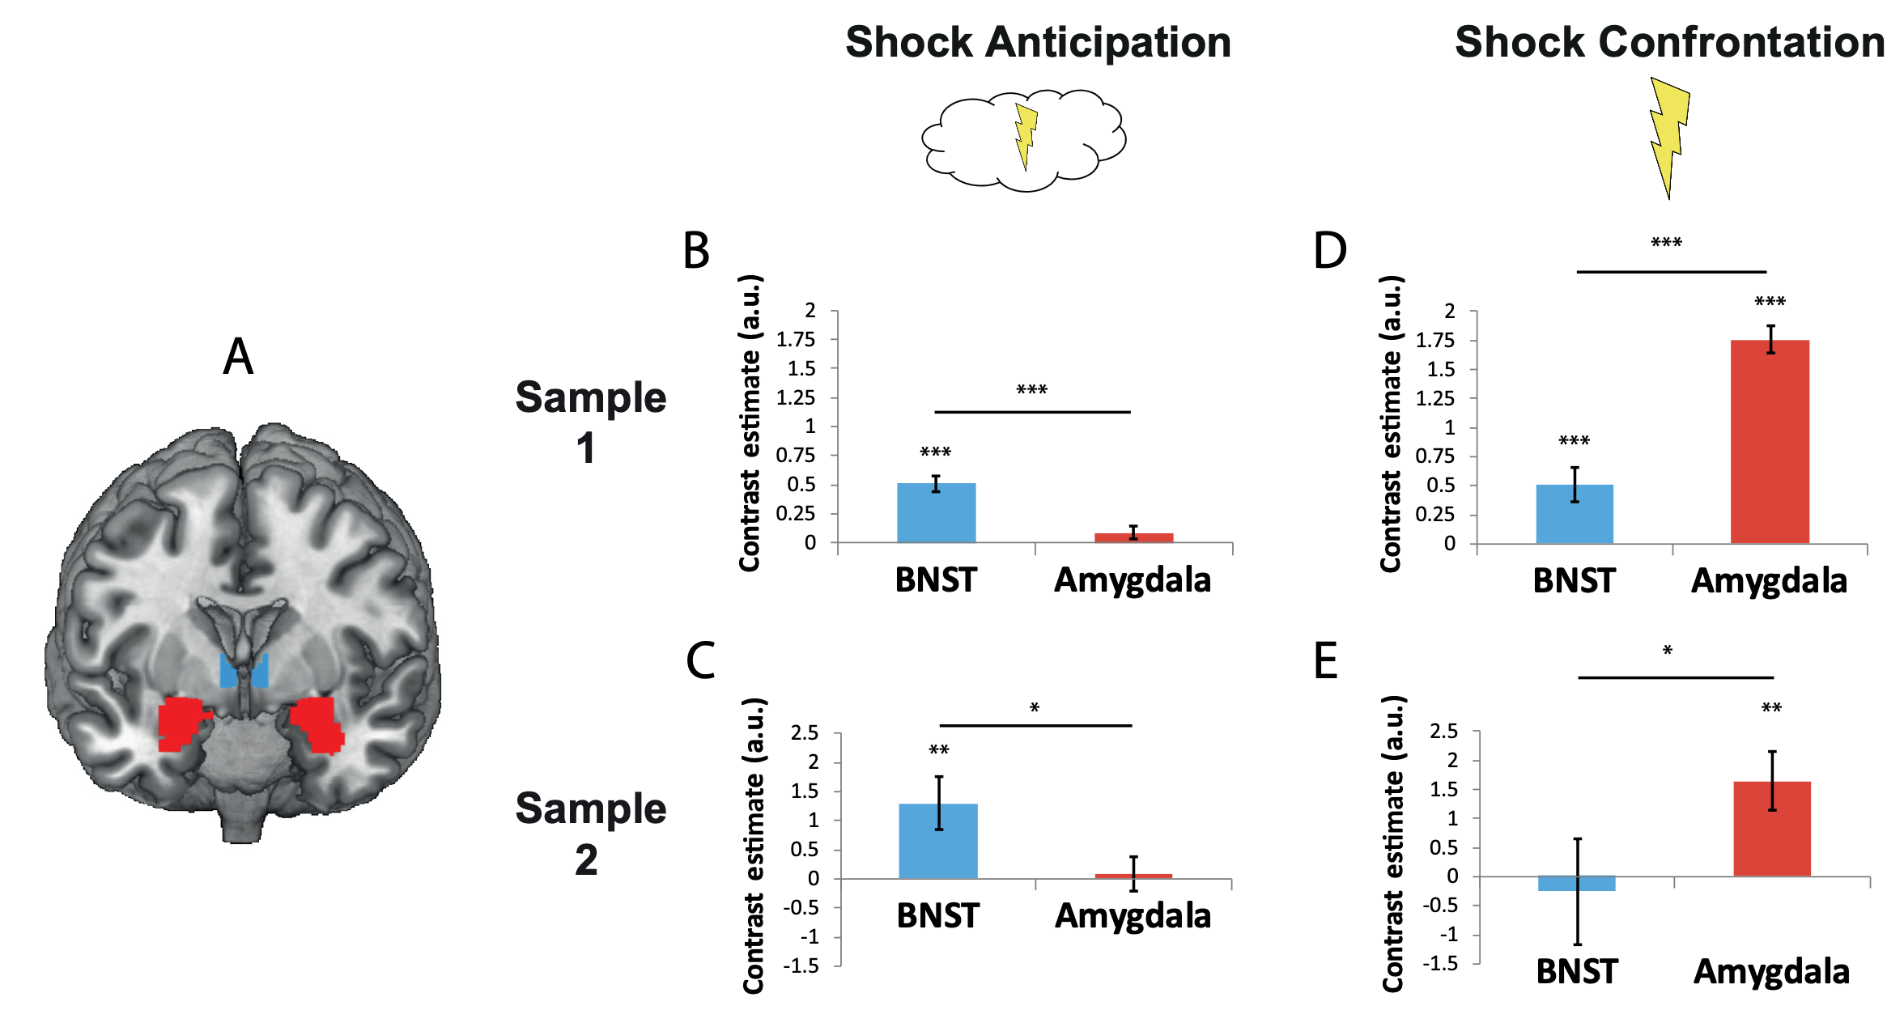
BNST anticipates, amygdala react to danger
Data were generated in two independent functional magnetic resonance imaging studies [n=108 males and n=70 (45 females)]
Klumpers et al, 2017, J. Neurosci., 37(40): 9645–9656

Slide 29
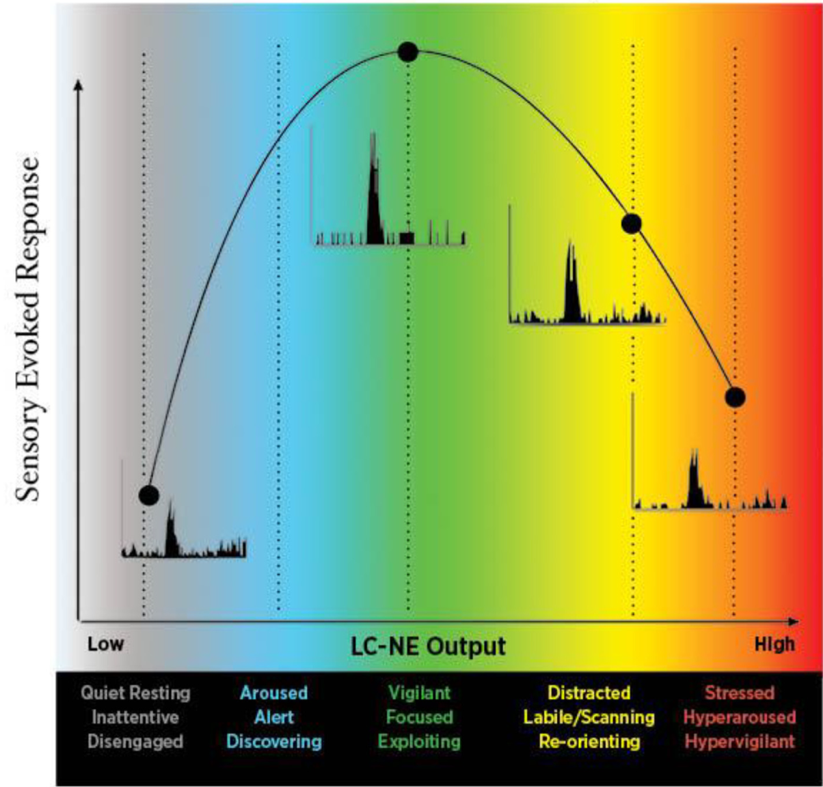
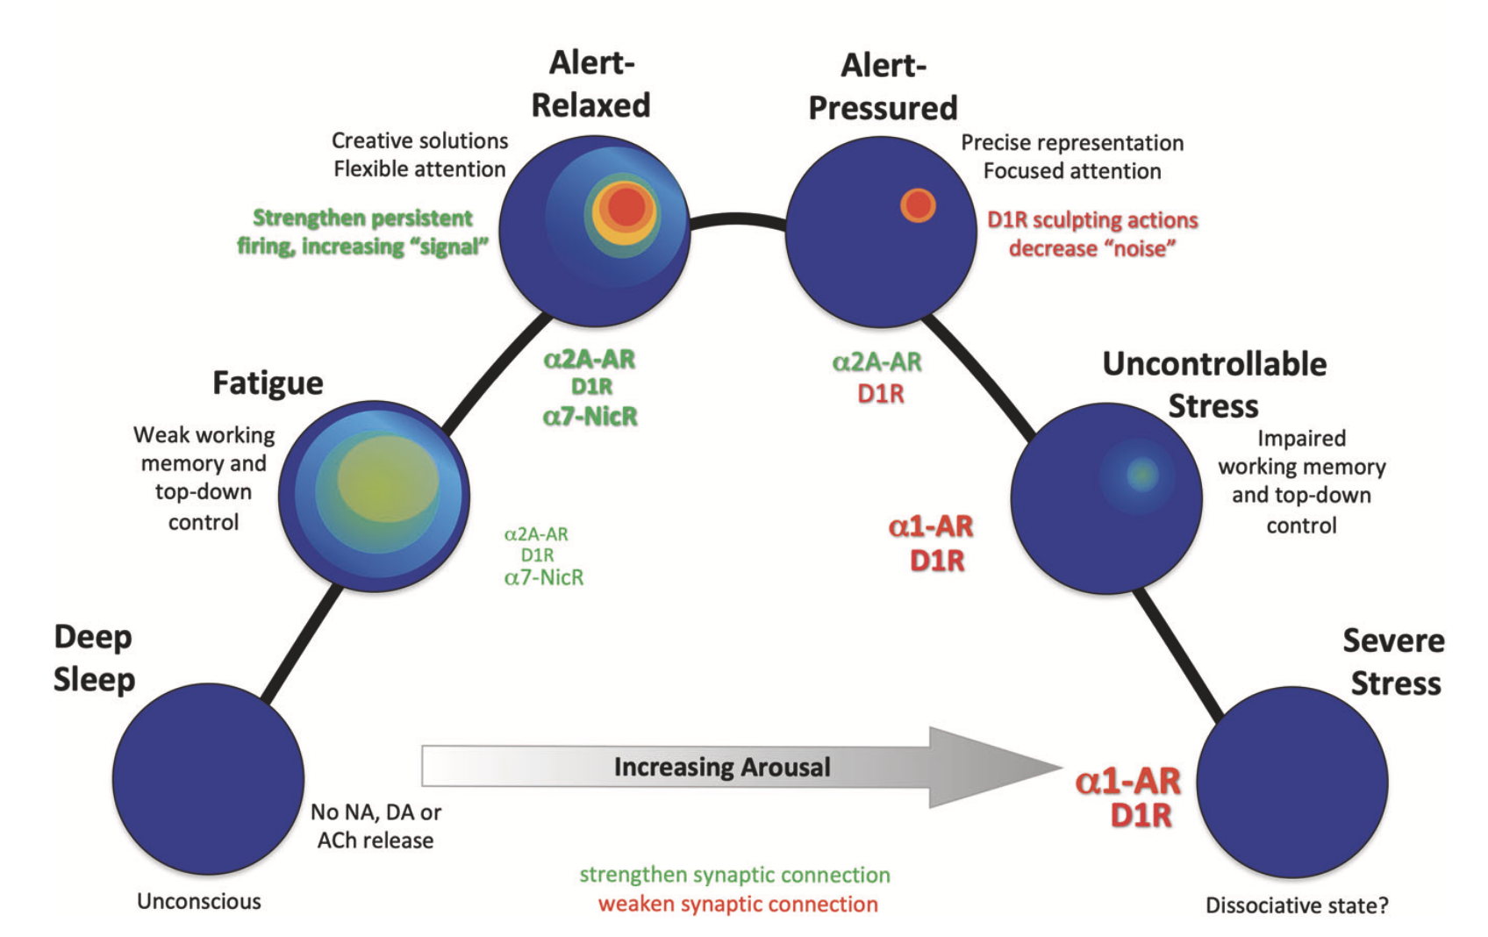
Catecholamine Regulation of PFC Activity and Sensory Circuits (CEN & SMN)
Alert-
Relaxed
Alert-
Pressured
Creative solutions
Flexible attention
Precise representation
Focused attention
Strengthen persistent
firing, increasing “signal”
D1R sculpting actions
decrease “noise”
Uncontrollable
Stress
Fatigue
⍺2A-AR
D1R
⍺7-NicR
⍺2A-AR
D1R
Impaired
working memory
and top-down
control
Weak working memory and top-down control
⍺1-AR
D1R
Severe
Stress
Deep
Sleep
⍺2A-AR
D1R
⍺7-NicR
Increasing Arousal
⍺1-AR
D1R
No NA, DA, or
ACh release
Strengthen Synaptic Connection
Weaken Synaptic Connection
Unconscious
Dissociative state?
LOW
HIGH
Quiet Resting
Inattentive
Disengaged
Aroused
Alert
Discovering
Vigilant
Focused
Exploiting
Distracted
Labile/Scanning
Reorienting
Stressed
Hyperarousal
Hypervigilant
Cools. Neuropsychopharmacology. 2021;47:309. Waterhouse. Brain Res. 2019;1709:1.
Slide credit: clinicaloptions.com
Notes:
PFC, prefrontal cortex

Slide 30
Reflective to Reactive: Catecholamine Regulation of Prefrontal Cortex, Limbic and Paralimbic Areas
A
Top-down control of emotion
B
Stressed/depressed:
unregulated emotional circuits
Lateral
Lateral
Anterior cingulate cortex BA24; BA25 (subgenual cingulate); BA10 frontopolar or dorsomedial PFC: dlPFC dorsolateral PFC; BA32 dorsal anterior cingulate; SNc substantia nigra pars compacta, supplies striatum with dopamine
dIPFC
Self-perpetuating state
dIPFC
Catecholamines:
Locus coeruleus (NE)
SN/VTA (DA)
Catecholamines:
Locus coeruleus (NE)
SN/VTA (DA)
Top-down Regulation
Amygdala
Amygdala
25
Visceromotor Outputs
Visceromotor Outputs
10m
25
32
10m
32
24
24
Medial
Medial
Slide credit: clinicaloptions.com
Yang. Front Psychiatry. 2021;12:654322.

Slide 31
Symptomatic Expression of Altered
Central Nervous System Norepinephrine Activity
Central Noradrenergic Activity | Overactive | Underactive
Sympathetic activity | Increase | Decrease
Arousal level | Hyperarousal | Underarousal
Sleep | Insomnia | Hypersomnia
Emotion | Sensitive, anxious, instable → Agitation, fear, or aggression | Insensitive, sedated → Blunted affect, apathy
CNS = central nervous system.
Yamamoto K, et al. Psychiatry Clin Neurosci. 2014;68(1):1-20.

Slide 32
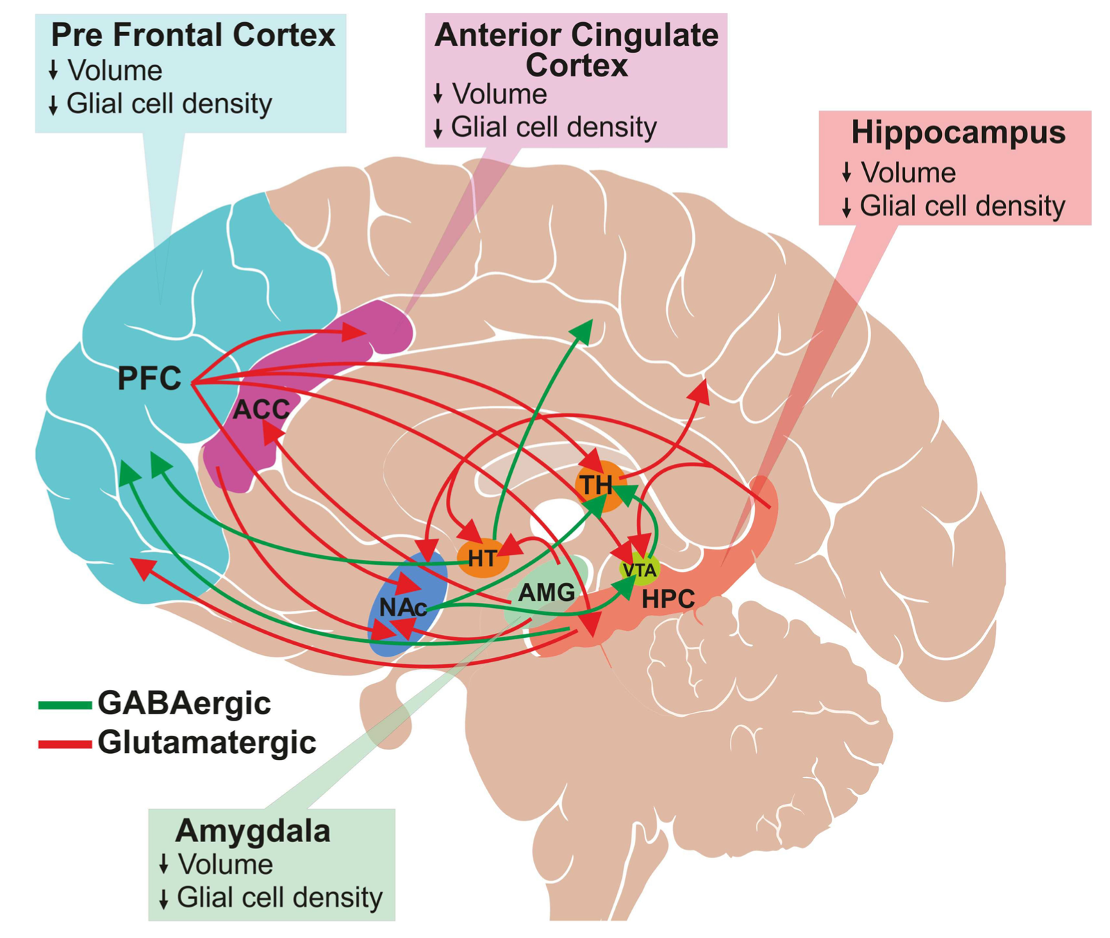
GABA and glutamate pathways
Anterior cingulate cortex (ACC), thalamus (TH), ventral tegmental area (VTA), hippocampus (HPC), nucleus accumbens (NAc), hypothalamus (HT), prefrontal cortex (PFC).
Sarawagi et al, Front Psychiatry. 2021; 12: 637863.

Slide 33
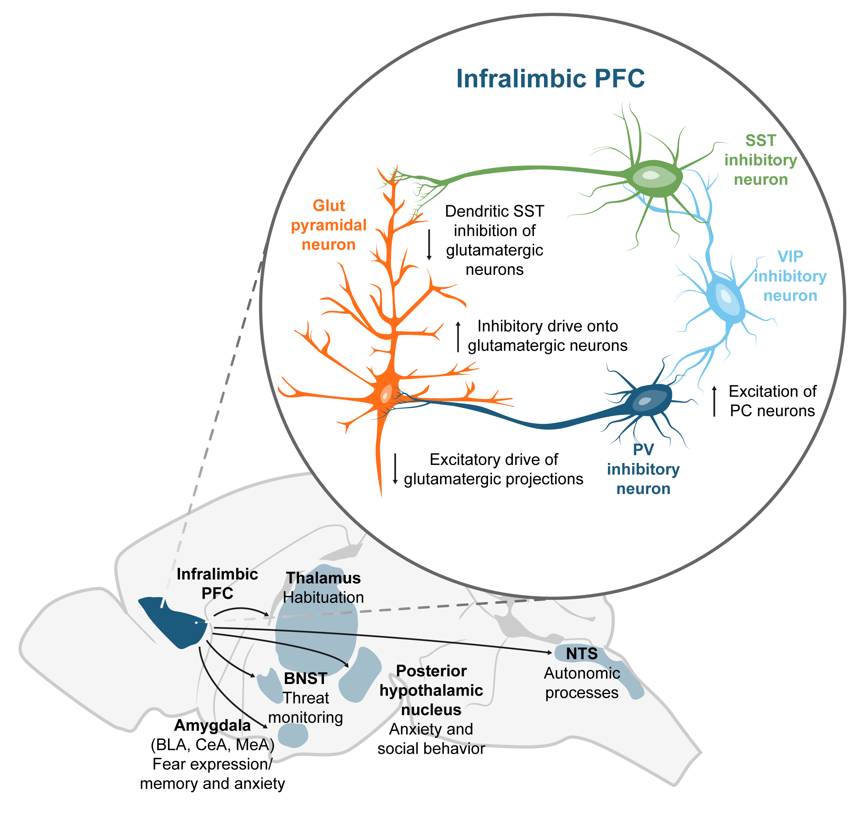

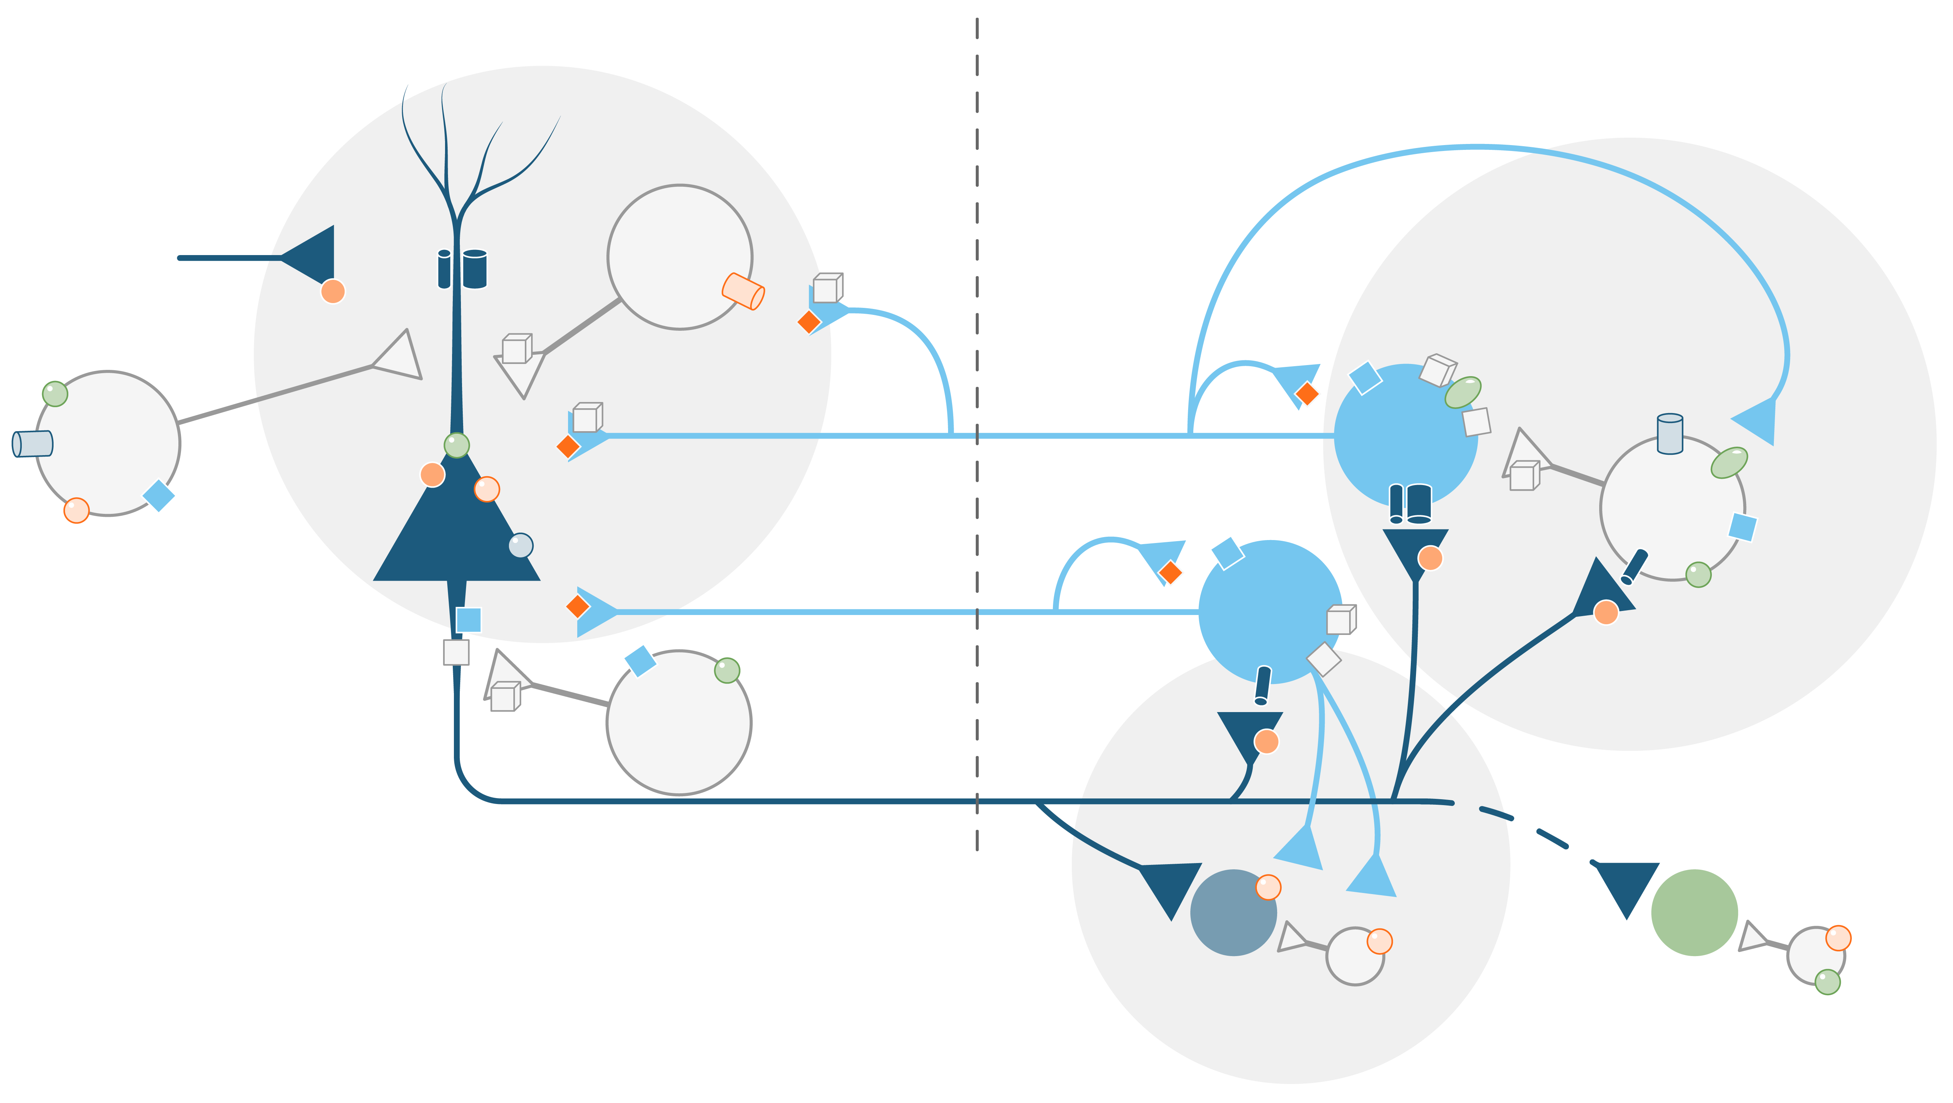
Glutamate, GABA and monoamine signaling: A case of mistaken identity?
About 70% of pyramidal Glu neurons and about 30% of GABA neurons express 5-HT_{1A} and 5-HT_{2A} receptors^{1,2}
Cortical circuits and glutamatergic projections from the PFC to the brainstem ultimately regulate functional brain stem nuclei³
An altered glutamate and GABA neurotransmission might appear as a disturbance in monoamine signaling
5-HT_{1A}
5-HT_{1B}
PFC
Brainstem
5-HT_{2A}
5-HT_{2B}
5-HT_{2C}
Cortex
Thalamus
Hippocampus
Amygdala
2.
GABA
5-HT₃
SST
1.
5-HT₄
5-HT_{2A}
5-HT₃
5-HT_{1B/1D}
5-HT_{1A}
GABA
5-HT_{1B/1D}
5HT
5-HT_{2B}
5-HT₇
5-HT₇
5-HT₇
5-HT_{2A}
5-HT_{1B/1D}
5-HT_{2B}
AMPA
5-HT_{2c}
5-HT_{1A}
Glu
5-HT_{2c}
5-HT_{1A}
GABA
5-HT_{1A}
5-HT₄
5-HT_{2A}
NMDA
5-HT_{1A}
5-HT_{1B/1D}
5-HT_{1B/1D}
5HT
mGluR II/III
Amygdala
Thalamus
Hypothalamus
BNST
5-HT_{1A}
5-HT_{2A}
3.
GABA
4.
GABA_{A}
PV
GABA_{B}
DA
5-HT_{2c}
NE
GABA
VTA
5-HT_{2c}
LC
5-HT_{2c}
GABA
5-HT_{2A}
Adapted from McKlveen JM, et al. Biol Psychiatry. 2019;86(9):669-681
Adapted from Yu C, et al. J Exp Pharmacol. 2020;12:285-300

Slide 34
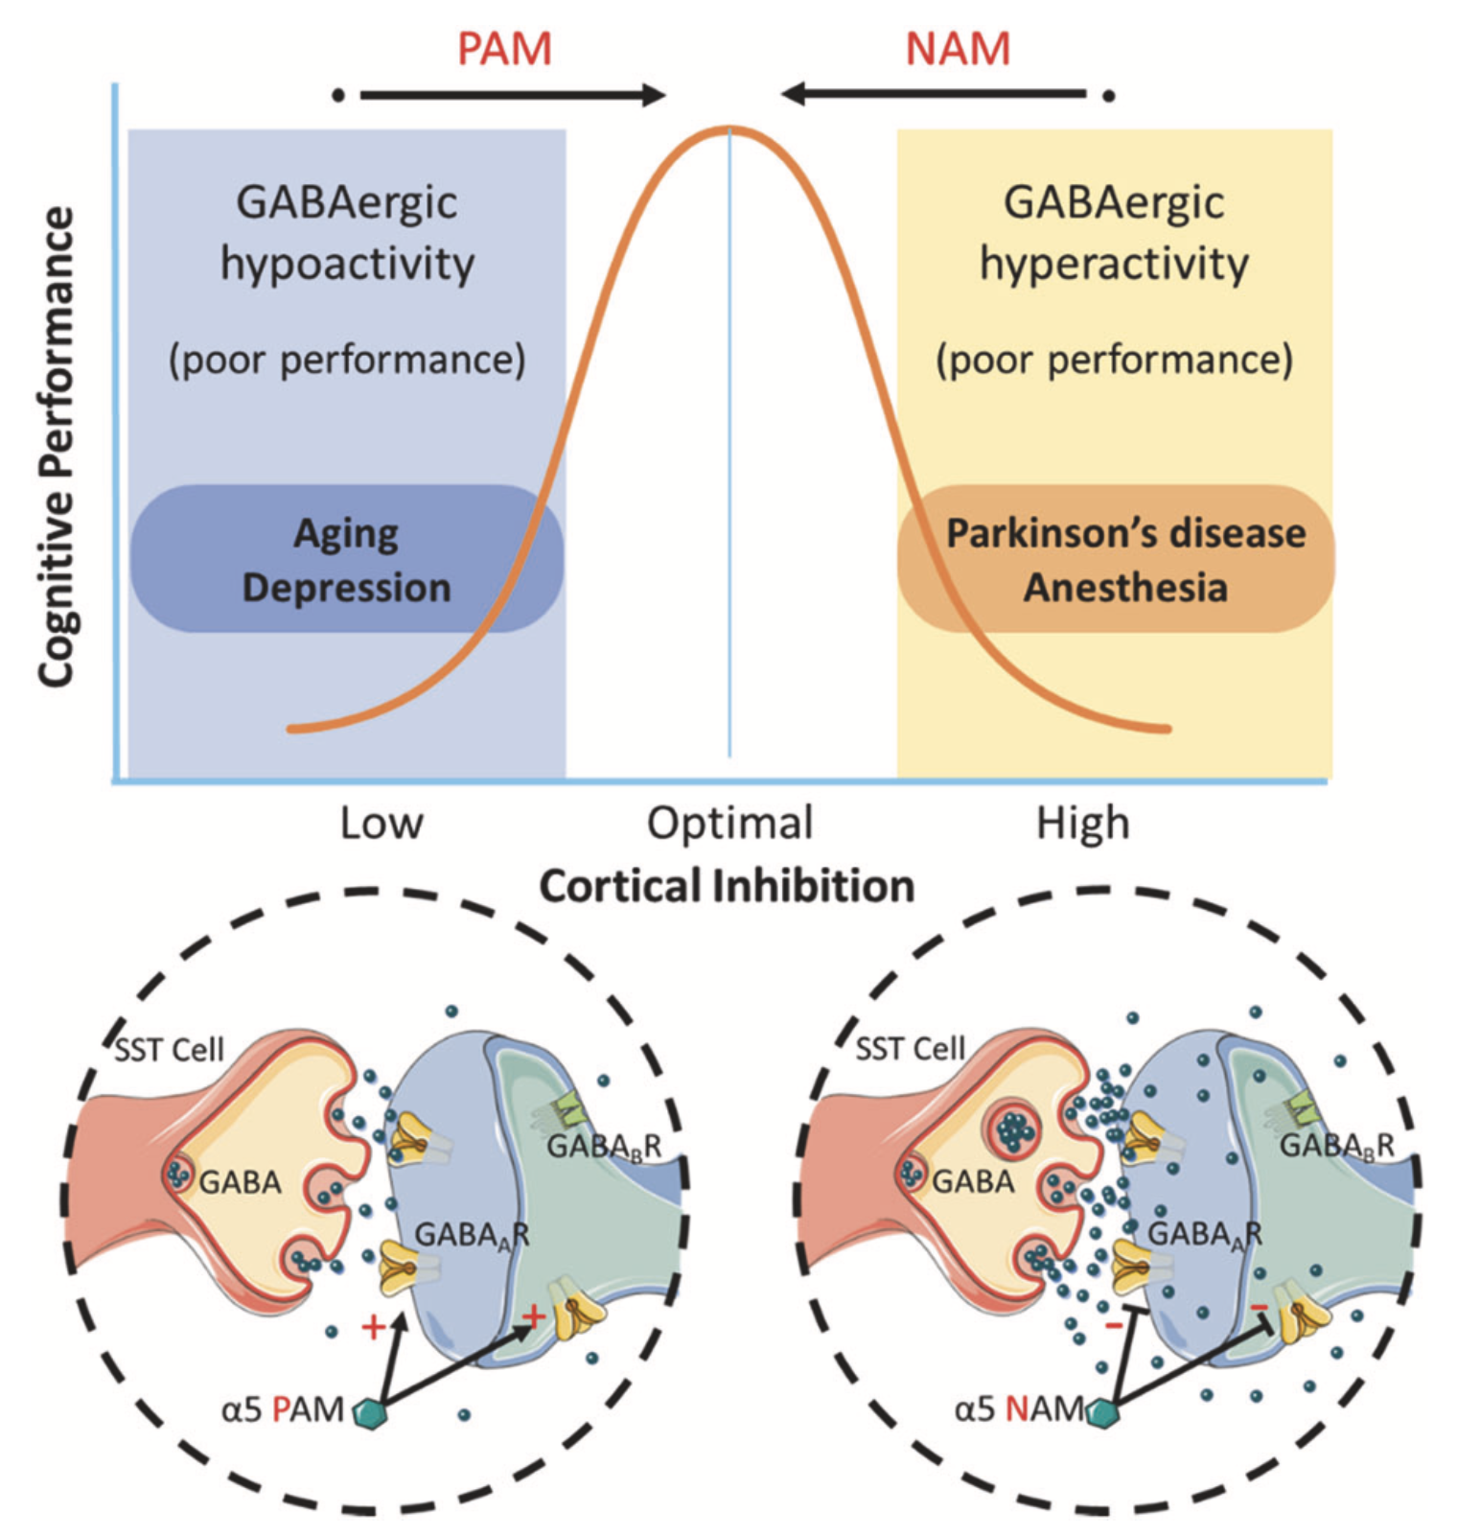
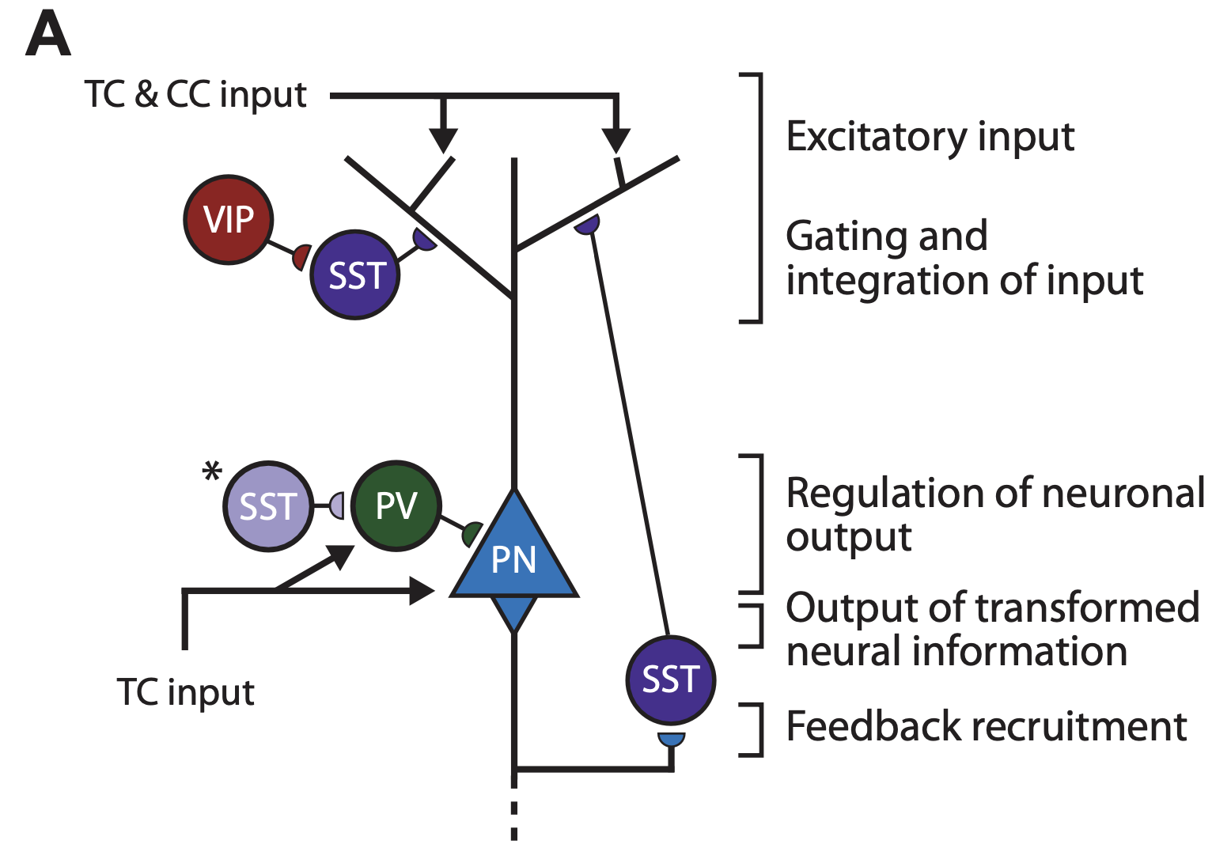
GABA SST malfunction = cortical microcircuit malfunction
Excitatory signals originate through thalamocortical (TC) and corticocortical (CC) projections that converge on pyramidal neurons (PNs). SST-expressing interneurons primarily regulate gating and integration of dendritic input through PN feedback recruitment. Vasoactive intestinal peptide (VIP)-expressing interneurons inhibit supragranular SST interneurons to facilitate excitatory input. In a healthy microcircuit (top) at baseline, SST interneurons exhibit high spontaneous activity that maintains sparse PN activation. In a pathological microcircuit (bottom), low SST function is predicted to result in increased PN baseline activity (i.e., increased noise) and low (signal-to-noise ratio) SNR.
Fee et al, 2017, Biological Psychiatry; 82:549–559;

Slide 35
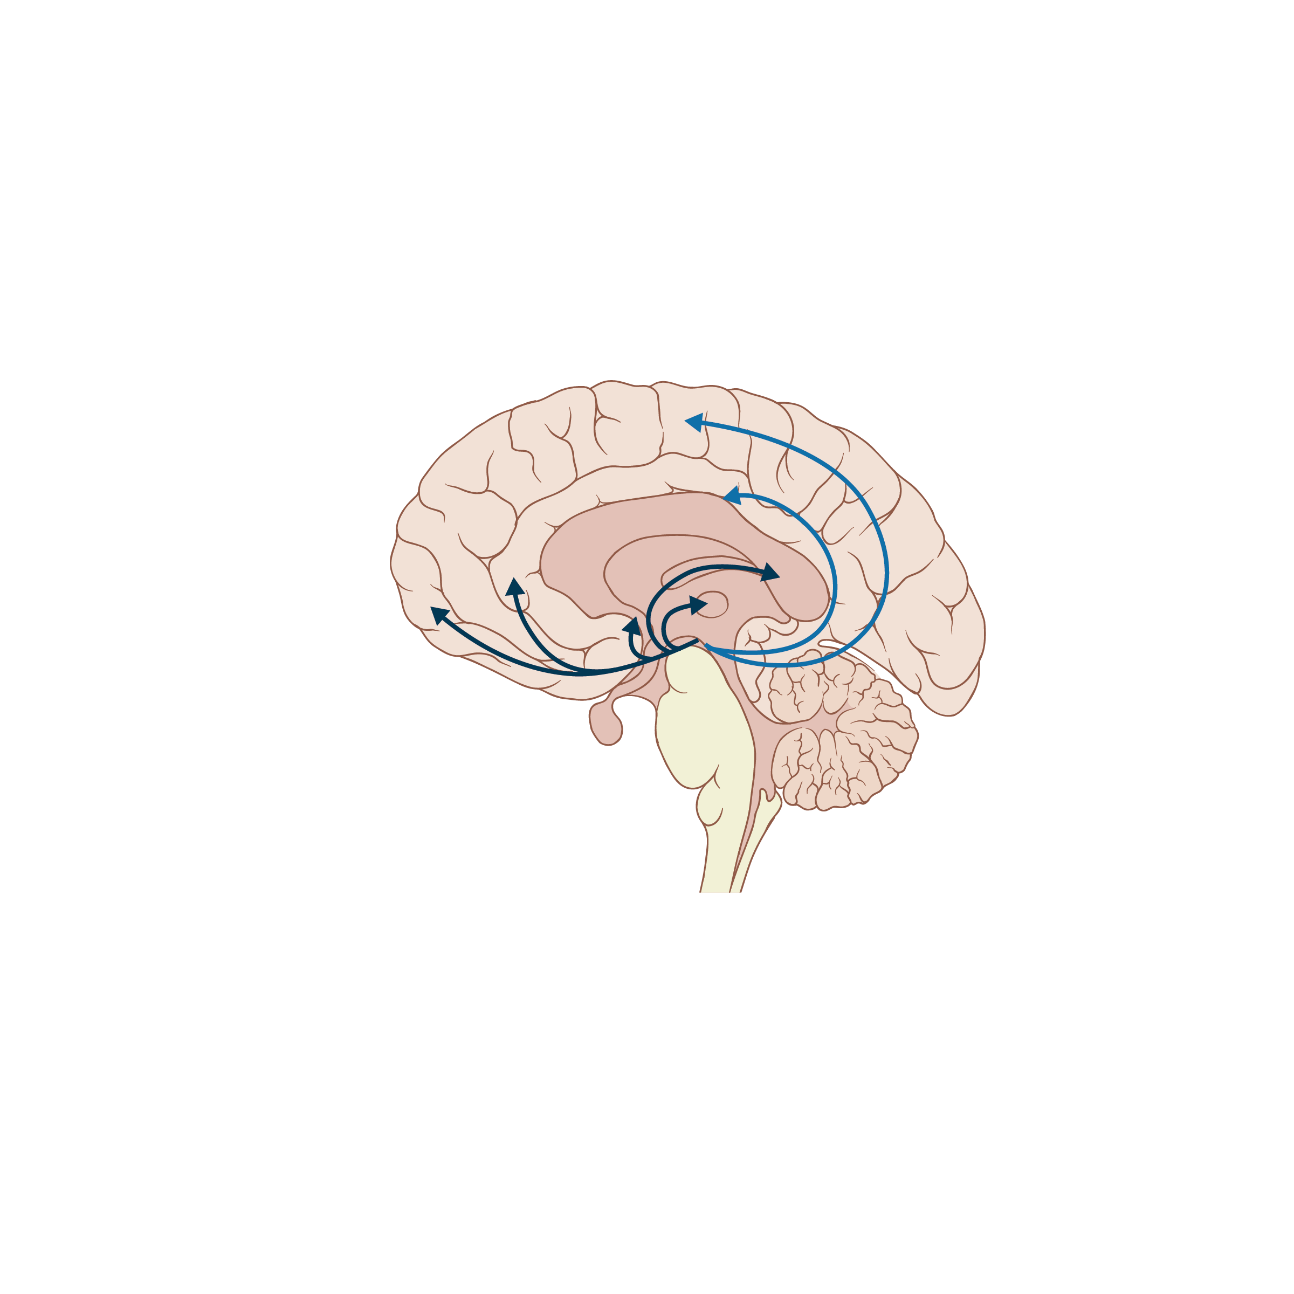
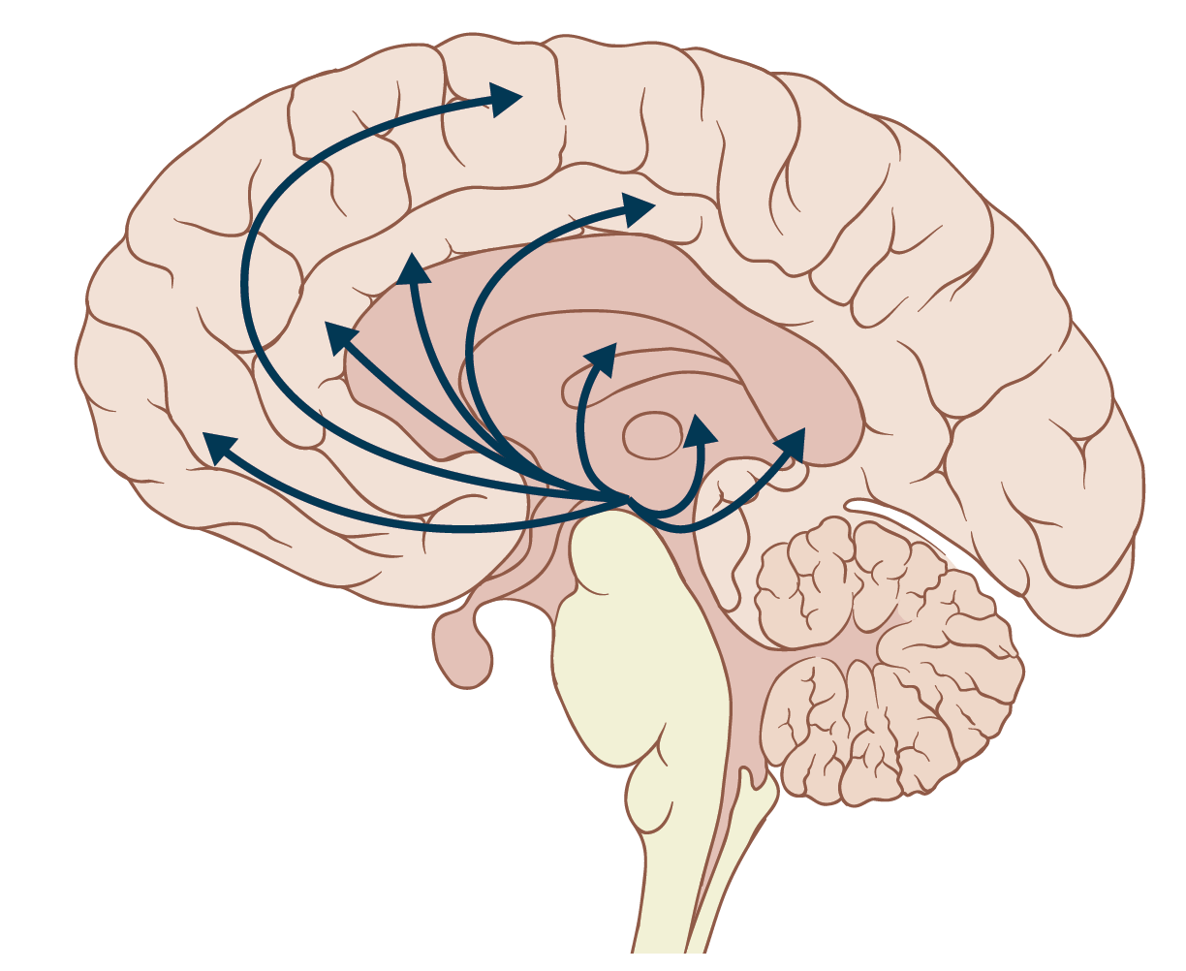
DA and 5-HT Roles in the Regulation of Functional Networks
DA
5HT
SM Cortices
SM Cortices
dACC
Insula
DStr
pACC
Stratium
pACC
DMT
vmPFC
vmPFC
PCC
VStr
DMT
PCC
VTA
SNc
RNi
SMN - ↑, DA
SMN - ↓ 5HT
DMN - ↓, DA
DMN - ↑5HT
SN - ↑, DA
SN - ↓ 5HT?
SNc substantia nigra pars compacta, VTA ventral tegmental area, DStr dorsal striatum, VStr ventral striatum, DMT dorsomedial thalamus, pACC perigenual anterior cingulate cortex, PCC posterior cingulate cortex, vmPFC ventromedial prefrontal cortex, SM sensorimotor, RNi raphe nuclei, dACC dorsal anterior cingulate cortex, RSNs resting state networks, SMN sensorimotor network, DMN default-mode network, SN salience network.
Conio B, et al. Mol Psychiatry. 2020;25:82-93.
Notes:
Fact checked (SB)
References
Conio B, et al. Mol Psychiatry. 2020;25(1):82-93. Figure 1; (arrows next to key are from the text)
SNc = substantia nigra pars compacta; VTA = ventral tegmental area; DStr = dorsal striatum; VStr = ventral striatum; DMT = dorsomedial thalamus; pACC = perigenual anterior cingulate cortex; PCC = posterior cingulate cortex; vmPFC = ventromedial prefrontal cortex; SM = sensorimotor; RNi = raphe nuclei; dACC = dorsal anterior cingulate cortex; RSNs = resting state networks; SMN = sensorimotor network; DMN = default mode network; SN = salience network.
SNc = substantia nigra pars compacta; VTA = ventral tegmental area; DStr = dorsal striatum; VStr = ventral striatum; DMT = dorsomedial thalamus; pACC = perigenual anterior cingulate cortex; PCC = posterior cingulate cortex; vmPFC = ventromedial prefrontal cortex; SM = sensorimotor; RNi = raphe nuclei; dACC = dorsal anterior cingulate cortex; RSNs = resting state networks; SMN = sensorimotor network; DMN = default mode network; SN = salience network.

Slide 36
Striatal Dopamine Function Is Associated With Balance Between Salience Network and DMN Activity
Salience Network
Default Mode Network
SAL - DMN Network Balance
0.40
0.2
0.35
0.1
0.30
Network Strength (z)
SAL-DMN Difference in Network Strength (z)
0.0
0.25
0.20
-0.1
0.15
0.011
0.012
0.013
0.014
0.015
0.011
0.012
0.013
0.014
0.015
Striatal dopamine synthesis capacity K_{i}^{cer} min⁻¹
Striatal dopamine synthesis capacity K_{i}^{cer} min⁻¹
Dopamine synthesis capacity was associated with greater SAL connectivity, and diminished DMN connectivity. This relationship was particularly apparent for brain regions that act as information-processing hubs.
McCutcheon et al. Biol Psychiatry. 2019;85:368.
Notes:
DMN, default mode network; SAL, salience network; DMN, default mode network.

Slide 37
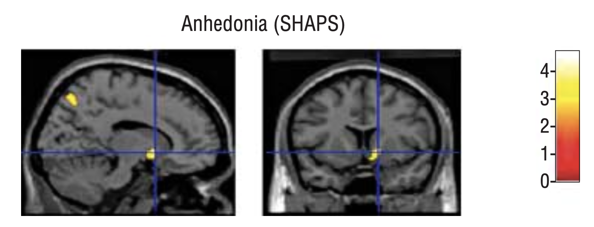
Depletion of Catecholamines in Remitted MDD Patients
Produces Anhedonia
Control group
RMDD group
12
Placebo
AMPT
*†‡
MADRS
MADRS
12
†
*
*
*
0
0
24
48
0
24
48
56
N. Accumb.
†
†
Area where glucose utilization correlated with AMPT-induced anhedonia (rated by negative scores from the SHAPS) in the right accumbens area, shown as voxel t values corresponding to
P <.005. N = 15 unmedicated participants with MDD in full remission and 13 healthy controls. Induction of catecholamine depletion by oral administration of AMPT.
SHAPS
48
SHAPS
40
0
24
48
0
24
48
Time after first drug intake, h
Time after first drug intake, h
*Significant diagnosis effect (RMDD participants vs controls, P <.05).
†Significant treatment effect for RMDD participants. ‡Significant treatment effect for controls.
Hasler et al. Arch Gen Psychiatry. 2008;65:521.
Notes:
AMPT, α-methylparatyrosine; CD, catecholamine depletion; MADRS, Montgomery-Asberg Depression Rating Scale; MDD, major depressive disorder; RMDD, MDD in full remission; SHAPS, Snaith-Hamilton Pleasure Scale.

Slide 38
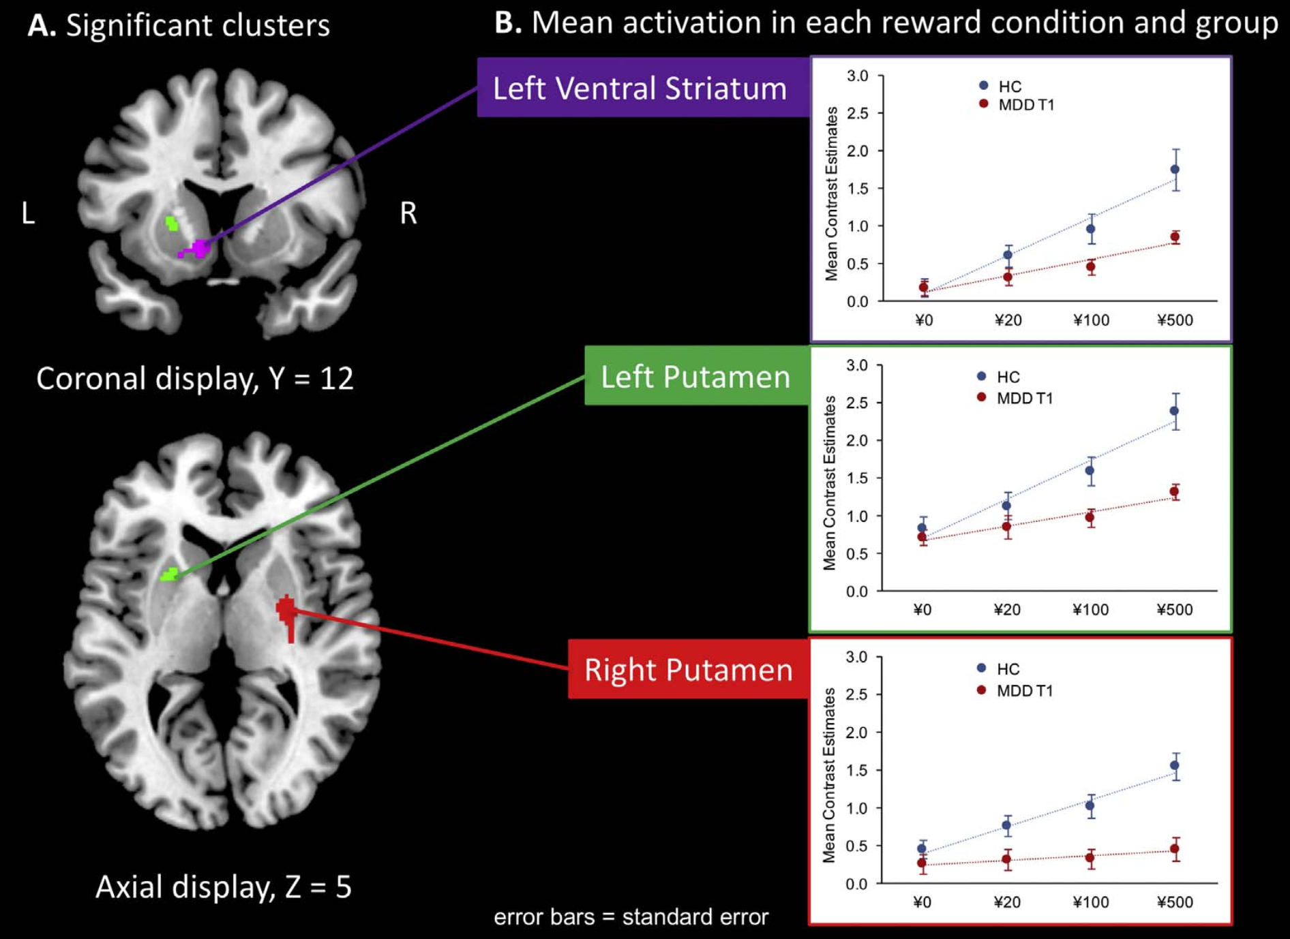
Patients With MDD Have Reduced Reward Coding in the Striatum After 6-Wk Treatment With an SSRI
n = 12 patients with MDD
n = 12 healthy volunteers
Patients participated in additional fMRI sessions after a 6-wk pharmacologic treatment with escitalopram, an SSRI
B. Mean Activation in Each Reward Condition and Group
Left Ventral Striatum
3
HC
MDD T1
2.5
2
Mean Contrast Estimates
1.5
1
0.5
0
¥0
¥20
¥100
¥500
3
HC
MDD T1
Left Putamen
2.5
2
Mean Contrast Estimates
1.5
1
0.5
0
¥0
¥20
¥100
¥500
Right Putamen
3
HC
MDD T1
2.5
2
Mean Contrast Estimates
1.5
1
0.5
0
¥0
¥20
¥100
¥500
Response to monetary reward
Takamura et al. Prog Neuropsychopharmacol Biol Psychiatry. 2017;79:317.
Notes:
HC, healthy controls; fMRI, functional magnetic resonance imaging; MDD T1, major depressive disorders at time 1; SSRI, selective serotonin reuptake inhibitor.

Slide 39
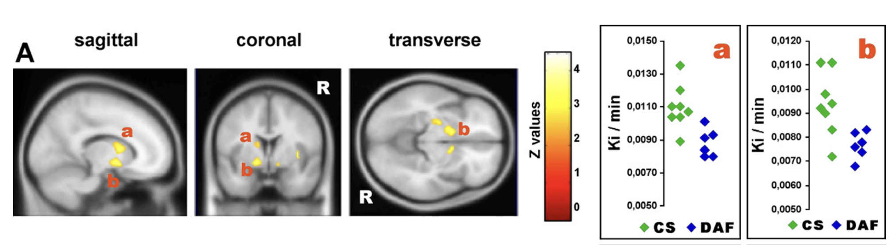
Patients with affective flattening have decreased dopamine function in n.accumbens
Caudate
N. Accumbens
N=8
N=6
Patients with affective flattening and psychomotor retardation had [18F]dopa Ki decreases in the left caudate, bilateral putamen and nucleus accumbens, left parahippocampus and dorsal brainstem.
Clusters of voxels denoting significant decreases of [18F]dopa Ki uptake in depressives with affective flattening (DAF) vs controls (CS). Decreases are shown in the left caudate (a: Talairach's coordinates of peak voxel: x=−11, y=7, z=8), in the left and right accumbens nuclei (b: Talairach's coordinates of left accumbens peak voxel: x=−14, y=3, z=−7).
Bragulat et al, 2007, Psychiatry Research: Neuroimaging, 154: 115–124

Slide 40
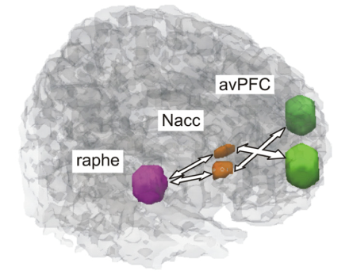
The Impact of SSRI and NDRI on N. Accumbens Response
Left Nacc ROI Activation:
Erotic > Neutral Video Clips
0.5
0.4
0.3
fMRI: Task-Related
Differential Signal
0.2
0.1
0
Placebo
Bupropion
Paroxetine
Cumulative Ratings of
Subjective Sexual Dysfunction
18 healthy male subjects were investigated using fMRI within a double-blind cross-over within-subjects study design and administering the SSRI paroxetine, bupropion, and placebo for 7 days each
20
*
15
MGH Sexual Function
Questionnaire
10
5
*P < .05.
fMRI = functional magnetic resonance imaging.
Abler, et al. J Neuroscience. 2012;32(4):1329-1335.
Abler, et al. Neuropsychopharmacology. 2011;36:1837-1847.
Enrollment
Placebo
Bupropion
Paroxetine

Slide 41
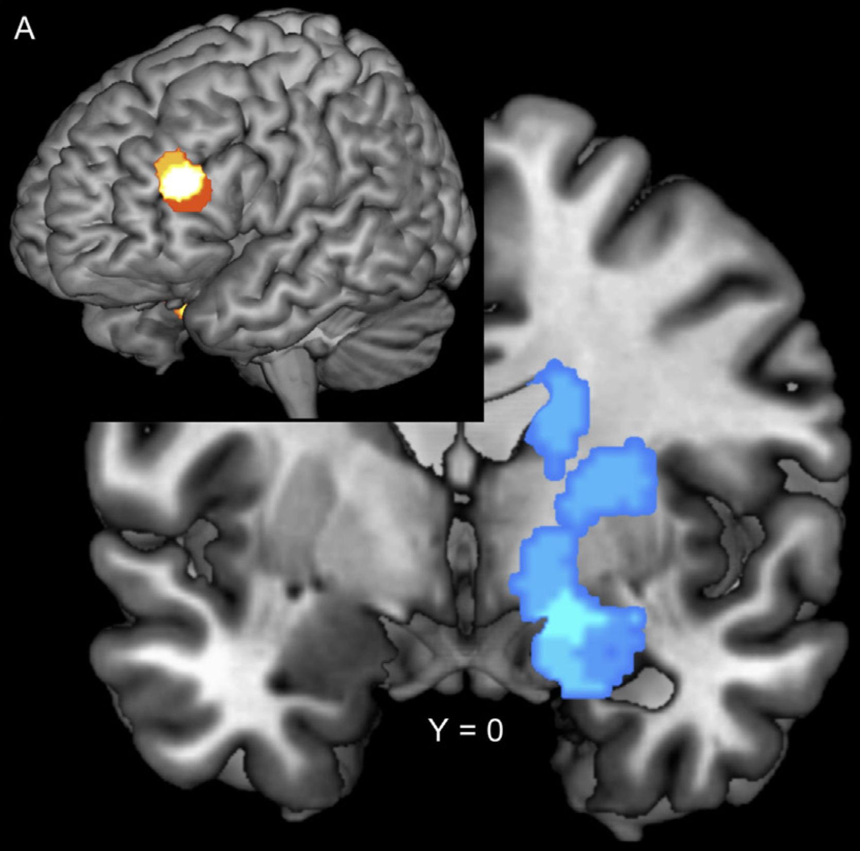
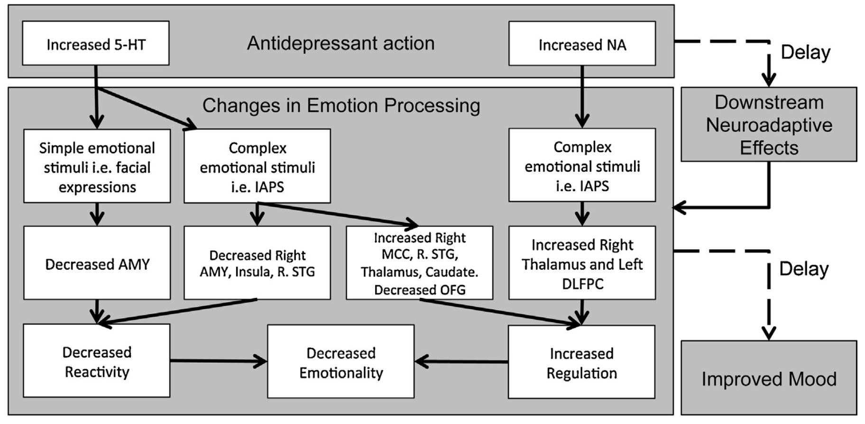
5HT decreases limbic reactivity NA increases emotional regulation
Differential acute effects of SSRIs and NRIs on emotion processing.
Antidepressant type × task type interaction showing increased activation cluster of left DLPFC and a decreased activation cluster of the right amygdaloid-hippocampal region.
International Affective Picture System (IAPS)
Outhred et al, 2013, Neuroscience and Biobehavioral Reviews, 37:1786–1800

Slide 42
Serotonin Regulation of Brain Network Function
5-HT_{2A}R Activation Levels
5-HT_{2A}R activation may regulate network coupling by setting a threshold for network oscillation synchronization and brainwave amplitude phase coupling across neural ensembles and between brain structures. Lower 5-HT_{2A}R activation would be associated with a decrease in network coupling, favoring attention and working memory. On the opposite side of the spectrum, high 5-HT_{2A}R activation would be associated with an increase in network coupling, favoring cognitive flexibility.
Threshold for network oscillation synchronization and brainwave amplitude phase coupling
Network uncoupling
Network coupling
Favors
Favors
Attention and working memory
Inhibitory control response
Cognitive flexibility
Aznar et al. Neurosci Biobehav Rev. 2016;64:63.

Slide 43
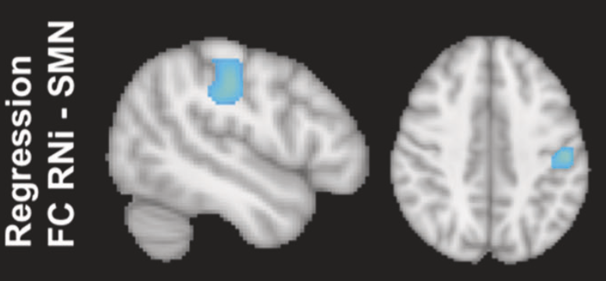
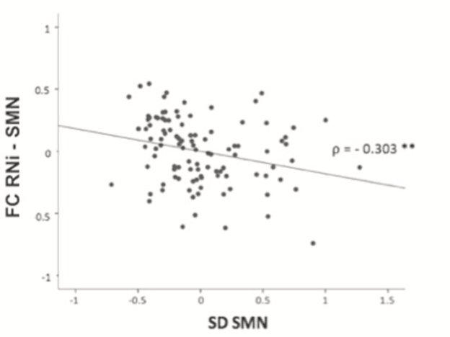

Increased 5HT signaling (RNi) is associated with diminished SMN activity
RNi raphe nuclei (5HT), SMN sensorimotor network, FC functional connectivity, SD neuronal variability.
Conio B et al., 2020, Mol Psychiatry, 25(1): 82-93

Slide 44
5HT reduction (tryptophane depletion) increases experience of pleasant touch and diminishes cold tolerance
200
Mean pleasantness rating
*
3
Tolerance (s)
150
2
ATD
Treatment
Control
Tryptophan Depletion
100
1
50
0
0
0.2
0.5
1
2 5
10
20
50
Velocity (cm/s)
Control
Tryptophan Depletion
Treatment
Affiliative tactile interactions help regulate physiological arousal and confer resilience to acute and chronic stress. C-tactile afferents (CTs) are a population of unmyelinated, low threshold mechanosensitive cutaneous nerve fibres which respond optimally to a low force stimulus, moving at between 1 and 10 cm/s. In a double blind, placebo-controlled design, the effect of acute tryptophan depletion (ATD) on 25 female participants’ ratings of directly and vicariously experienced touch was investigated. Psychophysical techniques were used to deliver dynamic tactile stimuli; some velocities were targeted to optimally activate CTs (1–10cm/s).
Depletion of central serotonin levels modulates neural and behavioral responsiveness to appetitive sensory signals.
Trotter et al, 2022, Psychopharmacology, aop

Slide 45
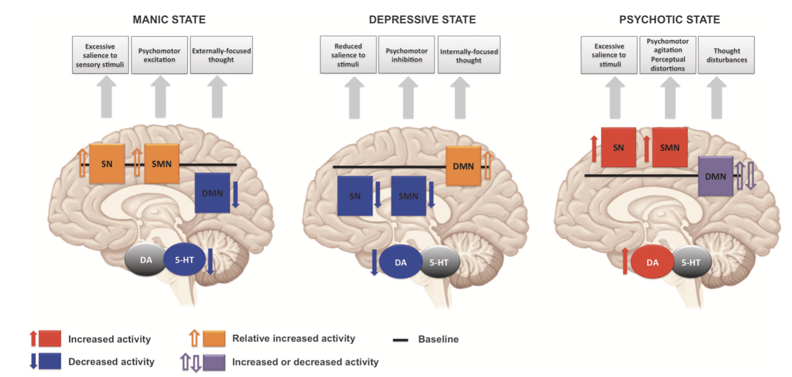
Altered Function of Neural Networks
Associated with Bipolar Disorder
DMN
SN
SMN
Conio B, et al. Mol Psychiatry. 2020;25(1):82-93.

Slide 46
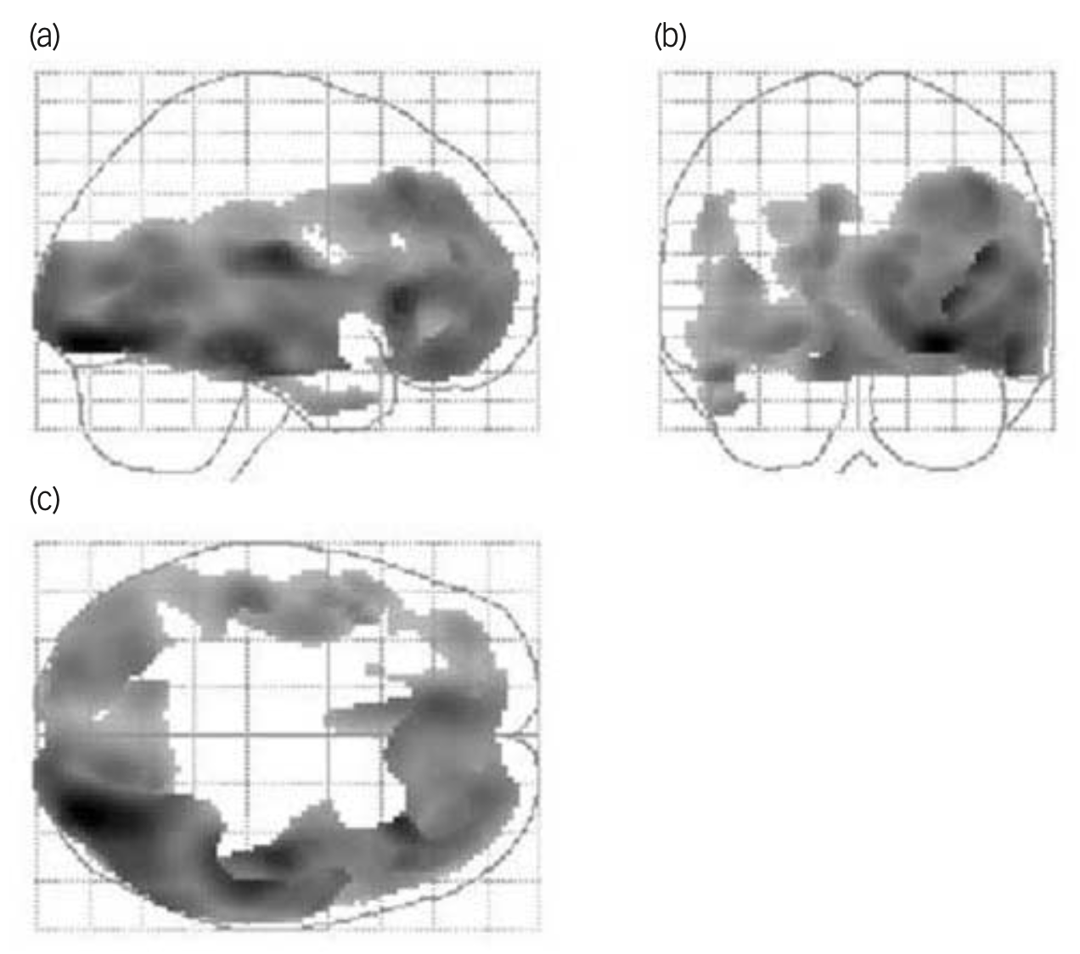
Diminished 5HT signaling in mania
Diagnosis
Control Depression
Mania
15
PRL (ng/ml)
12
9
6
Participants (n=10) with DSM–IV bipolar I disorder – manic episode and healthy controls (n=10) underwent [18F]- setoperone scans.
Individuals with current mania had significantly lower 5-HT2 receptor binding potential in frontal, temporal, parietal and occipital cortical regions.
0
15
30
Time (min)
45
60
PRL (prolactin) responses to i.v. CMI in male healthy control subjects (n = 15) and patients with depression (n = 22) or with mania (n = 11). Values are means ± SEM. i.v. clomipramine (CMI)
Lykouras et al, 2011, Neuropsychobiology; 63:77–81; Yatham et al, 2010,The British Journal of Psychiatry, 196: 47–51.

Slide 47
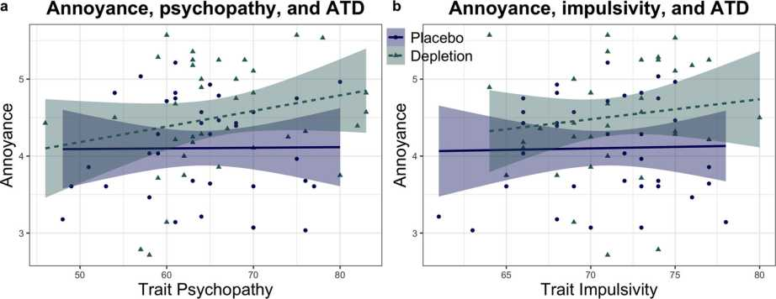
Acute tryptophane depletion (5HT) increases annoyance, and trait psychopathy and impulsivity
N=73, double-blind randomized trial; ATD= acute tryptophane depletion
Kanen et al. 2021, Translational Psychiatry, 11:81

Slide 48

Elevated Norepinephrine (NE) Levels May Be Implicated in Manic Episodes and Anger in BP Disorder
CSF NE levels
12
10
Anxiety
Plasma MHPG Levels (ng/mL)
*
8
0
Manic Syndrome
Response
Remission
Correlation of cerebrospinal fluid norepinephrine concentration with severity of anxiety in (n=32) medication-free manic patients (r=.53, P<.01). The degree of elevation of CSF NE levels in manic patients was significantly correlated with manic symptoms of dysphoria, anger, and anxiety.
State
Biochemical studies have also found significant differences in plasma levels of MHPG among the stages of the manic state (ie, manic syndrome, response, and remission)²
Notes:
In a study of BP manic patients, CSF NE concentrations were significantly elevated in manic patients compared with normal controls or depressed and euthymic patients¹
Although the degree of elevation of CSF NE levels in manic patients was not significantly correlated with manic severity, as measured by Bunney-Hamburg ratings, it was significantly correlated with ratings of dysphoria, anxiety, and anger
In another study in patients with BP disorder I, significant differences were observed in plasma levels of MHPG among the 3 stages of a manic episode (manic syndrome vs response [P=0.871], manic syndrome vs remission [P=0.006], and response vs remission [P=0.054])²
The Young Mania Rating Scale, or YMRS, score was used to define the 3 stages of a manic episode: manic syndrome (defined as YMRS ≥20), response (defined as <50% reduction in YMRS score), and remission (defined as YMRS score ≤8)
These results suggest that plasma level of MHPG acts as a biomarker for the progression of symptoms from the manic state to the remission state in BP disorder
References
Post RM, Rubinow DR, Uhde TW, et al. Dysphoric mania: clinical and biologic correlates. Arch Gen Psychiatry. 1989;46(4):353-358.
Kurita M, Nishino S, Numata Y, et al. The noradrenaline metabolite MHPG is a candidate biomarker from the manic to the remission state in bipolar disorder I: a clinical naturalistic study. PLoS One. 2014;9(6):e100634.

Slide 49


Psychomotor dysregulation in psychiatric disorders
Psychomotor mechanisms operate in a dimensional and cross-nosological way as their degrees of expression are related to levels of psychomotor activity (across different disorders) rather than to the diagnostic categories themselves.
DA
5HT
=
DA
=
5HT
=
DA
5HT
SN substantia nigra, RN raphe nucleus, BG basal ganglia, Thal thalamus, SMN sensorimotor network, DMN default-mode network.
Northoff et al, 2021, Molecular Psychiatry, 26:92–102

Slide 50

Psychomotor balance, functional networks and monoamine neurotransmitters
SN substantia nigra (DA), RN raphe nucleus (5HT), BG basal ganglia, Thal thalamus, SMN
sensorimotor network, DMN default-mode network, GA global activity
(DA)
(5HT)
(DA)
(5HT)
(DA)
(5HT)
Northoff et al, 2021, Mol Psychiatry. 26(1):92-102

Slide 51

Computerized cognitive training alters functional brain network connectivity
Improved performance on the Stroop Color-Word Test and Flanker Test were associated with decreased correlation between the default mode network (DMN) and the fronto-parietal network (FPN) (p < 0.05). Compared with BAT, CCT alone significantly decreased correlation between the left dorsolateral prefrontal cortex and both the left and right medial temporal gyrus.
Conclusion : Decreased correlation between DMN and FPN, indicating less connection between these networks, may be an underlying mechanism by which CCT improves executive functions. ^{1.}
^{2.}
N=124 adults aged 65–85 years enrolled in an 8-week randomized controlled trial of Computerized Cognitive Training (CCT). Participants were randomized to either: 1) group-based CCT 3x/week for 1 hour plus 3x/week home-based training; 2) group-based CCT preceded by brisk walking (Ex+CCT) 3x/week for 1 hour plus 3x/week home-based training; or 3) group-based balanced and toned (BAT) classes 3x/week for 1 hour (control).
1. Brinke et al, 2021, Journal of Alzheimer's Disease, vol. 80, no. 4, pp. 1525-1537; 2. Bursky et al, 2022, Brain Sci., 12, 663.

Slide 52

Exercise rapidly increased BDNF in healthy elderly individuals
The study exposed n=19 healthy older adults to 35-minute sessions of physical exercise, cognitive training, and mindfulness practice, and compared the resulting changes in mature BDNF levels between the three activities. A balanced within-subject crossover design was utilized, meaning that all participants went through the three different training programs in a sequence order that had been randomly assigned to each of them.
(1) physical aerobic exercise at a moderate level by using the interactive Xbox KinectTM application (http://en.wikipedia.org/wiki/Kinect), (2) cognitive training through a computerized working memory training program (CogMedTM, http://www.cogmed.com/program), and (3) mindfulness practice through the use of the Mindfulness App (http://www.mindapps.se/themindfulnessapp/).
Hakansson et al, 2017, J Alzheimers Dis. ; 55(2): 645–657.

Slide 53
Cognitive Therapy and Behavioral Activation Were Advantageous in Delaying Relapse
1.0
Continued medication (n=28)
0.9
Placebo (n=21)
Prior behavioral activation (n=27)
0.8
Prior cognitive therapy (n=30)
0.7
0.6
Survival
0.5
0.4
0.3
0.2
0.1
0.0
0
2
4
6
8
10
12
14
16
18
20
22
24
Time Since End of Treatment (Months)
Participants were initially assigned to 16 weeks of antidepressant treatment (n=100), cognitive therapy (n=45), and behavioral activation (n=43); treatment responders on antidepressants were randomized to continue with medication or placebo; relapse was defined as a HAM-D score of ≥14; recurrence was defined with the same criteria during the second year of follow-up
Adapted from Dobson KS, et al. J Consult Clin Psychol. 2008;76(3):468-477.
Notes:
Speaker Direction:
The researchers in this study asserted that although antidepressant medication has been shown to delay the return of symptoms associated with MDD for as long as it is continued, there was little evidence that antidepressant therapy does anything to alter the risk factors that lead to a subsequent relapse and recurrence of MDD
The primary aim of this trial was to determine the enduring effects of behavioral activation (BA), prior exposure to cognitive therapy (CT), and continued treatment with an antidepressant medication (ADM) in the context of a placebo-controlled trial; this figure illustrates the cumulative proportion of treatment responders who survived without relapse over the 2 years of follow-up (the vertical line indicates the point at which patients on continuation medication were withdrawn from medication)
The overall pattern of results in this study was that prior psychotherapy, either in the form of BA or CT, had an enduring effect that was at least as efficacious as continuing patients on medication and that held for the delay of relapse and possible recurrence
These results suggest that behavioral interventions may be enduring and may be at least equally beneficial as antidepressants in reducing the risk of relapse and recurrence of MDD
Background:
The subjects for this study were outpatients who met criteria for DSM-IV MDD and had scores ≥20 on the BDI-II and scores ≥14 on the 17-item version of the HAM-D; subjects were randomly assigned to a 16-week active acute treatment group, which included BA (n=43), prior exposure to CT (n=45), and treatment with an ADM (paroxetine, n=100); these subjects were then followed to the point of relapse or recurrence for up to 2 years following response to acute treatment and formed the sample for the current study (n=106); relapse was defined as either HAM-D scores of 14 or greater or psychiatric status ratings of 5 or greater for 2 successive weeks during the first year of follow-up; recurrence was defined with the same criteria during the second year of follow-up
The first year of follow-up (dotted line on slide) compared 4 groups of acute phase treatment responders: those who received prior CT (n=30), those who received prior BA (n=27), and those who received prior ADM (n=49), with the latter divided into 2 groups as specified below; patients who had received prior BA or prior CT received no further treatment during any follow-up phase of the study; treatment responders who had received ADM were randomized by previous assignment and were continued on active medication (cADM; n=28) or withdrawn onto pill-placebo at the beginning of the first year follow-up phase according to a predetermined 2-week taper schedule (cPLA; n=21); patients in cADM and cPLA continued to see their pharmacotherapists biweekly for the first 2 months and monthly thereafter during the rest of the first year of follow-up, and clinicians treated them using standard clinical management strategies; pharmacotherapists, evaluators, and patients were blind to medication status, meaning that the pharmacological portion of the trial was conducted triple-blind; cADM participants were continued on the same dosage prescribed during acute treatment, with adjustments allowed as clinically indicated; at the end of the first year of follow-up, pharmacotherapists discontinued cADM patients’ medication using the same taper schedule as was used for the cPLA participants; patients in both cADM and cPLA were seen biweekly during the taper period and were then assessed during the second follow-up year
Reference:
Dobson KS, Hollon SD, Dimidjian S, et al. Randomized trial of behavioral activation, cognitive therapy, and antidepressant medication in the prevention of relapse and recurrence in major depression. J Consult Clin Psychol. 2008;76(3):468-477.
38

Slide 54

DMN in a top-down fashion modulates 5HT and DA
Ventromedial prefrontal cortex (VMPFC), thalamus (THAL), posterior cingulate cortex (PCC), ventral tegmental area (VTA), substantia nigra (SNc), dorsal raphe nucleus (DRN), and nucleus centralis superior (NCS).
DE LA CRUZ et al, 2021, Hum Brain Mapp.;42:811–823.

Slide 55

DLPFC regulates DA release from VTA during reward motivated behavior
Connection strengths are indicated on each arrow (in hertz). Only the connections from dlPFC to VTA and NAcc are significantly modulated by reward motivation.
Ballard et al, 2011, J. Neurosci., 31(28):10340 –10346

Slide 56

Impact of Cognitive Therapy on Amygdala and Prefrontal (DLPFC) Activity in MDD
Emotional
Cognitive
Put the digits in numerical order
7 4 3 1 5
Is it you?
UGLY
0.20
0.35
0.15
0.30
0.25
0.10
0.20
BOLD Signal (% Change)
BOLD Signal (% Change)
0.05
0.15
0.10
0.00
0.05
-0.05
0.00
2
4
6
8
10
12
2
4
6
8
10
12
14
16
18
Time (s)
Time (s)
Pre
Post
Control
12 weeks cognitive therapy 9 depressed patients and 24 controls
DLPFC=Dorsolateral prefrontal cortex; MDD=Major depressive disorder.
DeRubeis RJ, et al. Nature Rev Neurosci. 2008;9:788–796.

Slide 57

Neuroimaging biomarker for treatment selection in MDD
A
1.15
Right Anterior Insula Normalized Metabolism
1.10
1.05
1.00
0.95
CBT NR
CBT REM
Escitalopram
REM
Escitalopram
NR
B
Escitalopram
CBT
Escitalopram
Right Anterior Insula Normalized Metabolism
CBT
Right Anterior Insula Normalized Metabolism
Right anterior insula
1.10
1.10
1
1.05
1.05
z Score
1.00
1.00
0
0.95
0.95
0.90
0.90
–1
– 100 – 50 0 50 % of Change in HDRS Score
– 100 – 50 0 50 % of Change in HDRS Score
Remitters
Nonresponders
Randomized assignment to 12 weeks of treatment with either escitalopram (n=40)(10-20 mg/d) or 16 sessions of manual-based cognitive behavior therapy (n=42).
McGrath et al, 2013, JAMA Psychiatry, in press

Slide 58
Practical Take-Aways
Aberrant functional brain network connectivity may underpin symptoms of multiple psychiatric disorders
Monoamines, GABA and glutamate regulate function of major functional networks and cortico-striatal-thalamo cortical “updating” loop
Pharmacological modulation of neurotransmission may “normalize” relationship between major functional brain networks and ameliorate neuroplasticity
Non-pharmacological interventions may also work through modulating brain networks

